Slide 1
Efficient Multi-User Indexing for Secure Keyword Search
PAIS ‘14, March 2014
Eirini Micheli, Giorgos Margaritis, Stergios V. Anastasiadis
Dept. of Computer Science & Engineering University of Ioannina, Greece

Slide 2
Keyword Search
Accumulated documents
enormous amount
Search is indispensable for
personal content archives
online social networks
cloud facilities

Slide 3
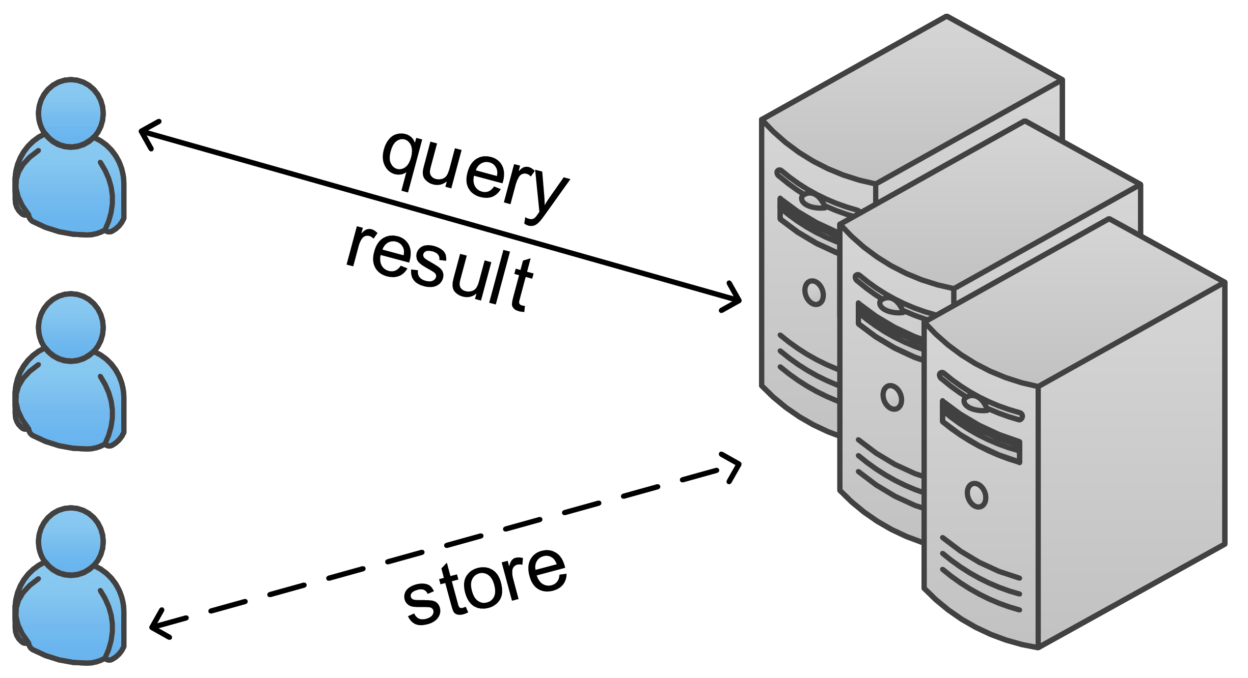
Shared Storage Environment
Co-located users
access control to protect documents
different access permissions per document
search for documents with keyword queries
Search engine
organizes documents into indices
preprocesses documents into posting lists
provides term occurrences across documents
returns matching documents

Slide 4
Confidentiality
Important aspect of search process
ensure search results do not leak confidential information
provide end-to-end confidentiality
conceal search activity and document content

Slide 5
Confidentiality
Important aspect of search process
ensure search results do not leak confidential information
provide end-to-end confidentiality
conceal search activity and document content
Prevent information leakage to unauthorized users
return only accessible documents

Slide 6
Confidentiality
Important aspect of search process
ensure search results do not leak confidential information
provide end-to-end confidentiality
conceal search activity and document content
Prevent information leakage to unauthorized users
return only accessible documents
Not enough to ensure confidentiality

Slide 7
Confidentiality Attack
Users can infer information about inaccessible documents
Bϋttcher et al. - USENIX Conference on File and Storage Technologies

Slide 8
Confidentiality Attack
Users can infer information about inaccessible documents
Insecure search environment
single shared index
vector space model
TF/IDF scoring function
Bϋttcher et al. - USENIX Conference on File and Storage Technologies

Slide 9
Confidentiality Attack
Users can infer information about inaccessible documents
Insecure search environment
single shared index
vector space model
TF/IDF scoring function
Estimate total number of documents containing given term
Including inaccessible documents
Bϋttcher et al. - USENIX Conference on File and Storage Technologies

Slide 10
Confidentiality Attack
Users can infer information about inaccessible documents
Insecure search environment
single shared index
vector space model
TF/IDF scoring function
Estimate total number of documents containing given term
create specific documents
issue customized queries
leverage search result relevance ranking
Including inaccessible documents
Bϋttcher et al. - USENIX Conference on File and Storage Technologies

Slide 11
Prior Work
One index per user
secure
- consumes disk space
Single document indexed multiple times

Slide 12
Prior Work
One index per user
secure
- consumes disk space
Single document indexed multiple times
Single shared index
Each document indexed once
storage efficiency
- security at extra list processing overhead

Slide 13
Prior Work
Partition documents by search permissions
documents searchable by same user set in single index
query handled over indices with searchable documents
secure
avoids result filtering of single shared index
- variations in search sets may increase number of indices

Slide 14
Prior Work
Partition documents by search permissions
documents searchable by same user set in single index
query handled over indices with searchable documents
secure
avoids result filtering of single shared index
- variations in search sets may increase number of indices
Reduce number of indices

Slide 15
Prior Work
Partition documents by search permissions
documents searchable by same user set in single index
query handled over indices with searchable documents
secure
avoids result filtering of single shared index
- variations in search sets may increase number of indices
Reduce number of indices
Take advantage of user commonality among searcher sets

Slide 16
Goals of Indexing Organization
Security
ensure confidentiality
Search efficiency
low search latency
Low indexing cost
document insertion I/O activity
indexing storage space

Slide 17
Lethe Approach
Document grouping
group documents with identical search sets
Clustering
cluster together document groups with similar search sets
Index creation
shared indices for common subset of searchers

Slide 18
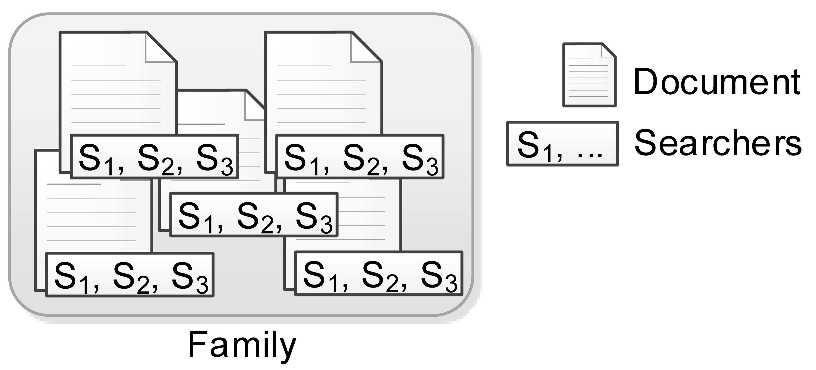
Group Documents into Families
Definitions
searcher: user authorized to search document by keywords
family: group of documents with identical search set
Create families
crawl the Path and Allowed Searchers of all documents
group together documents with identical search sets

Slide 19
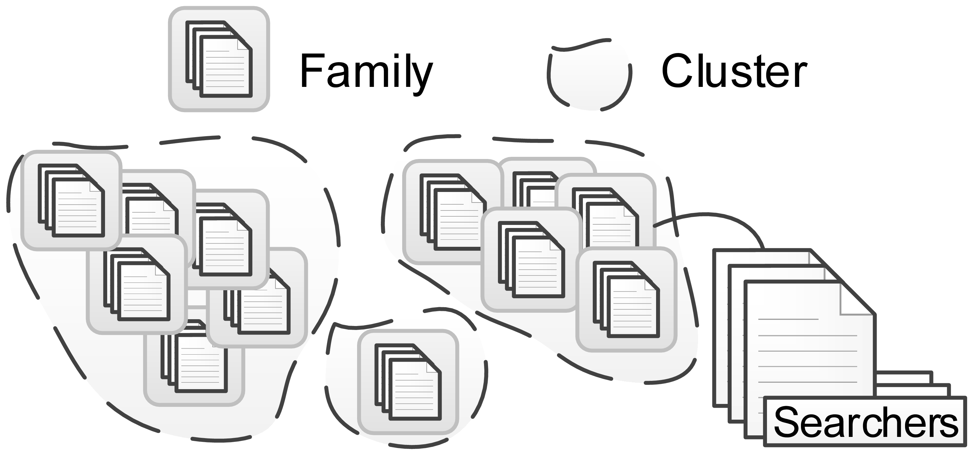
Cluster Families by Searcher Set
Apply clustering algorithm over searcher sets of families
Searcher Similarity L_{s} є [0, 1]
configurable parameter
adjust number of common searchers across cluster families
Clusters end up with one or more families

Slide 20
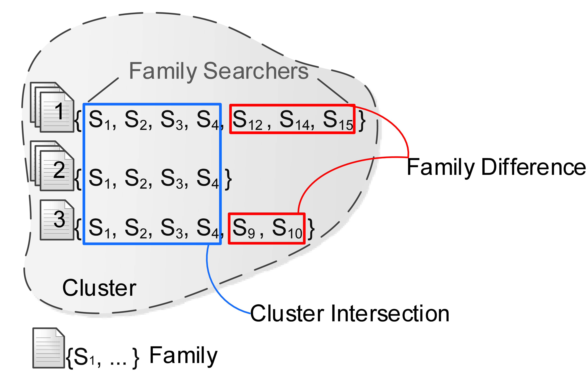
Intersections and Differences
Cluster intersection
subset of common searchers among cluster families
documents of all families in cluster
Family difference
searchers of family outside cluster intersection
documents of corresponding family

Slide 21
Map Families to Indices
Compute cluster intersection and family differences

Slide 22
Map Families to Indices
Compute cluster intersection and family differences
Dedicate single index to cluster intersection

Slide 23
Map Families to Indices
Compute cluster intersection and family differences
Dedicate single index to cluster intersection
What about family differences?

Slide 24
Map Families to Indices
Compute cluster intersection and family differences
Dedicate single index to cluster intersection
What about family differences?
Extreme approaches

Slide 25
Map Families to Indices
Compute cluster intersection and family differences
Dedicate single index to cluster intersection
What about family differences?
Extreme approaches
Approach 1: Difference documents in private indices

Slide 26
Map Families to Indices
Compute cluster intersection and family differences
Dedicate single index to cluster intersection
What about family differences?
Extreme approaches
Approach 1: Difference documents in private indices
Large number of duplicates

Slide 27
Map Families to Indices
Compute cluster intersection and family differences
Dedicate single index to cluster intersection
What about family differences?
Extreme approaches
Approach 1: Difference documents in private indices
Large number of duplicates
Approach 2: Dedicate single difference index

Slide 28
Map Families to Indices
Compute cluster intersection and family differences
Dedicate single index to cluster intersection
What about family differences?
Extreme approaches
Approach 1: Difference documents in private indices
Large number of duplicates
Approach 2: Dedicate single difference index
Many indices serve small number of documents & searchers

Slide 29
Separate Index per Difference?
Approximate document duplication per difference
introduce duplication product R
R = |difference documents| x |difference searchers|

Slide 30
Separate Index per Difference?
Approximate document duplication
introduce duplication product R
R = |difference documents| x |difference searchers|
Duplication threshold T_{d} є [0, ∞)
configurable parameter
adjust number of duplicates per difference

Slide 31
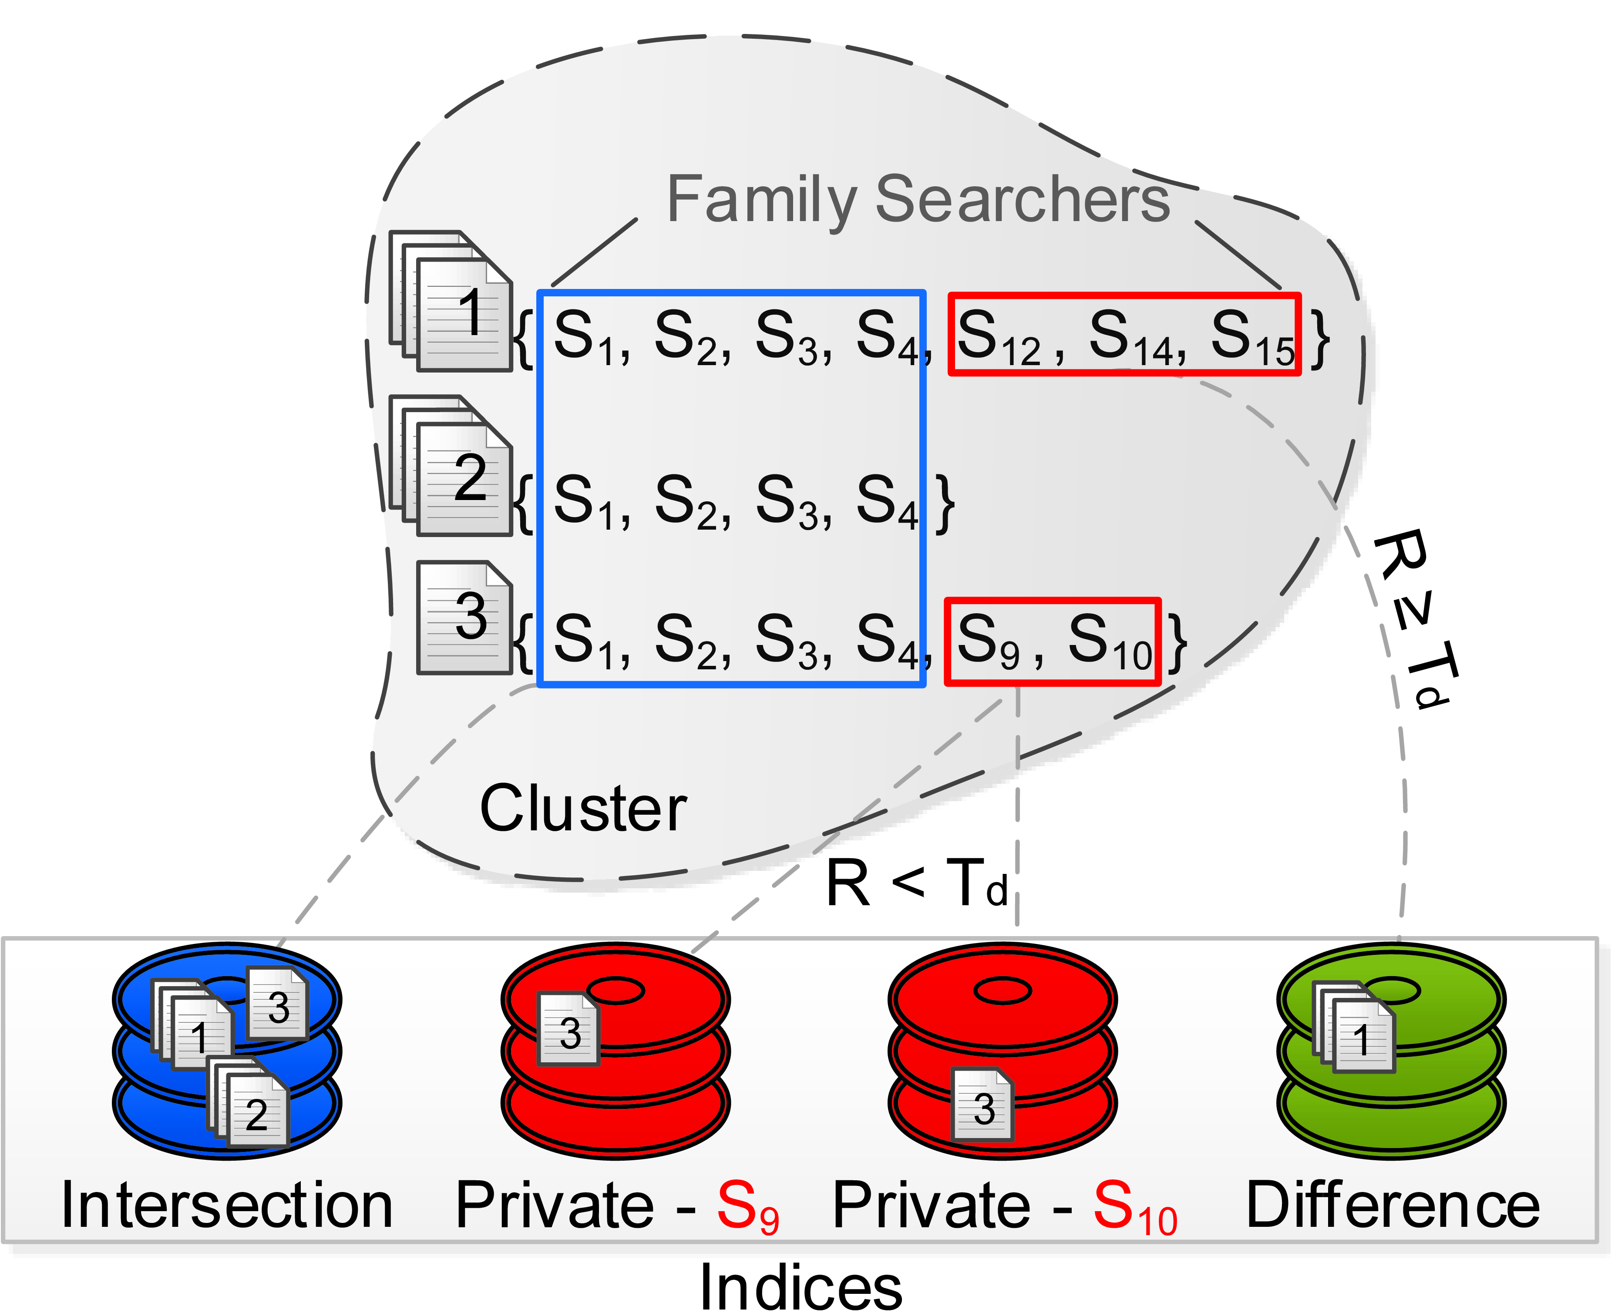
Separate Index per Difference?
Approximate document duplication
introduce duplication product R
R = |difference documents| x |difference searchers|
Duplication threshold T_{d} є [0, ∞)
configurable parameter
adjust number of duplicates per difference
Check whether R < T_{d}
yes: copy to private indices
no: single difference index

Slide 32
Index Documents
Index documents into appropriate indices
use index specifications from mapping stage
Manage forthcoming documents
look for existing indices with identical searcher set
Manage document deletions or modifications
change indices content
reorganize mapping of indices to documents
Optimize search
periodically repeat clustering and mapping stage

Slide 33
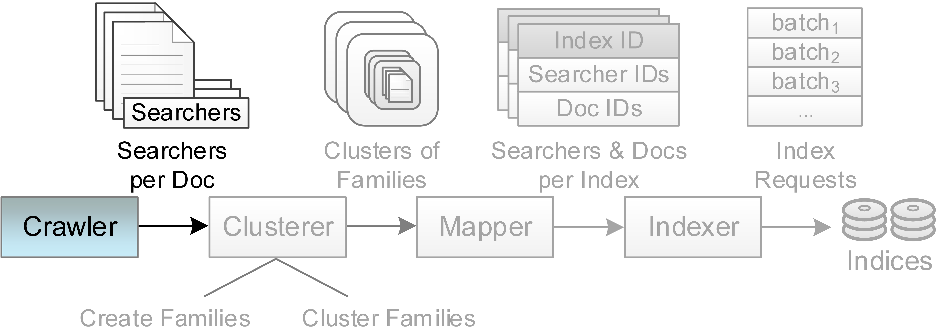
Prototype Implementation
Crawler
gather information for document searchers
specify unique identifier to each document

Slide 34
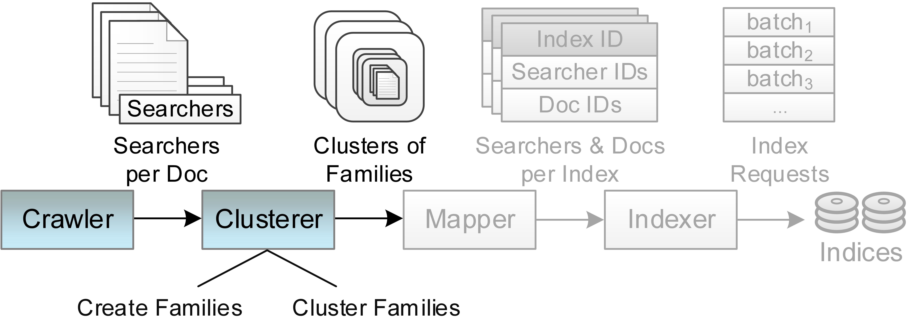
Prototype Implementation
Clusterer
create families over hash table
cluster families with DBSCAN

Slide 35
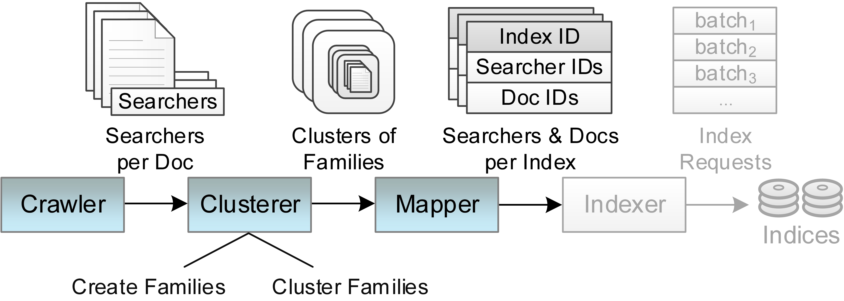
Prototype Implementation
Mapper
identify cluster intersections and family differences
dedicate single index to each cluster intersection
dedicate indices to family differences based on T_{d}

Slide 36
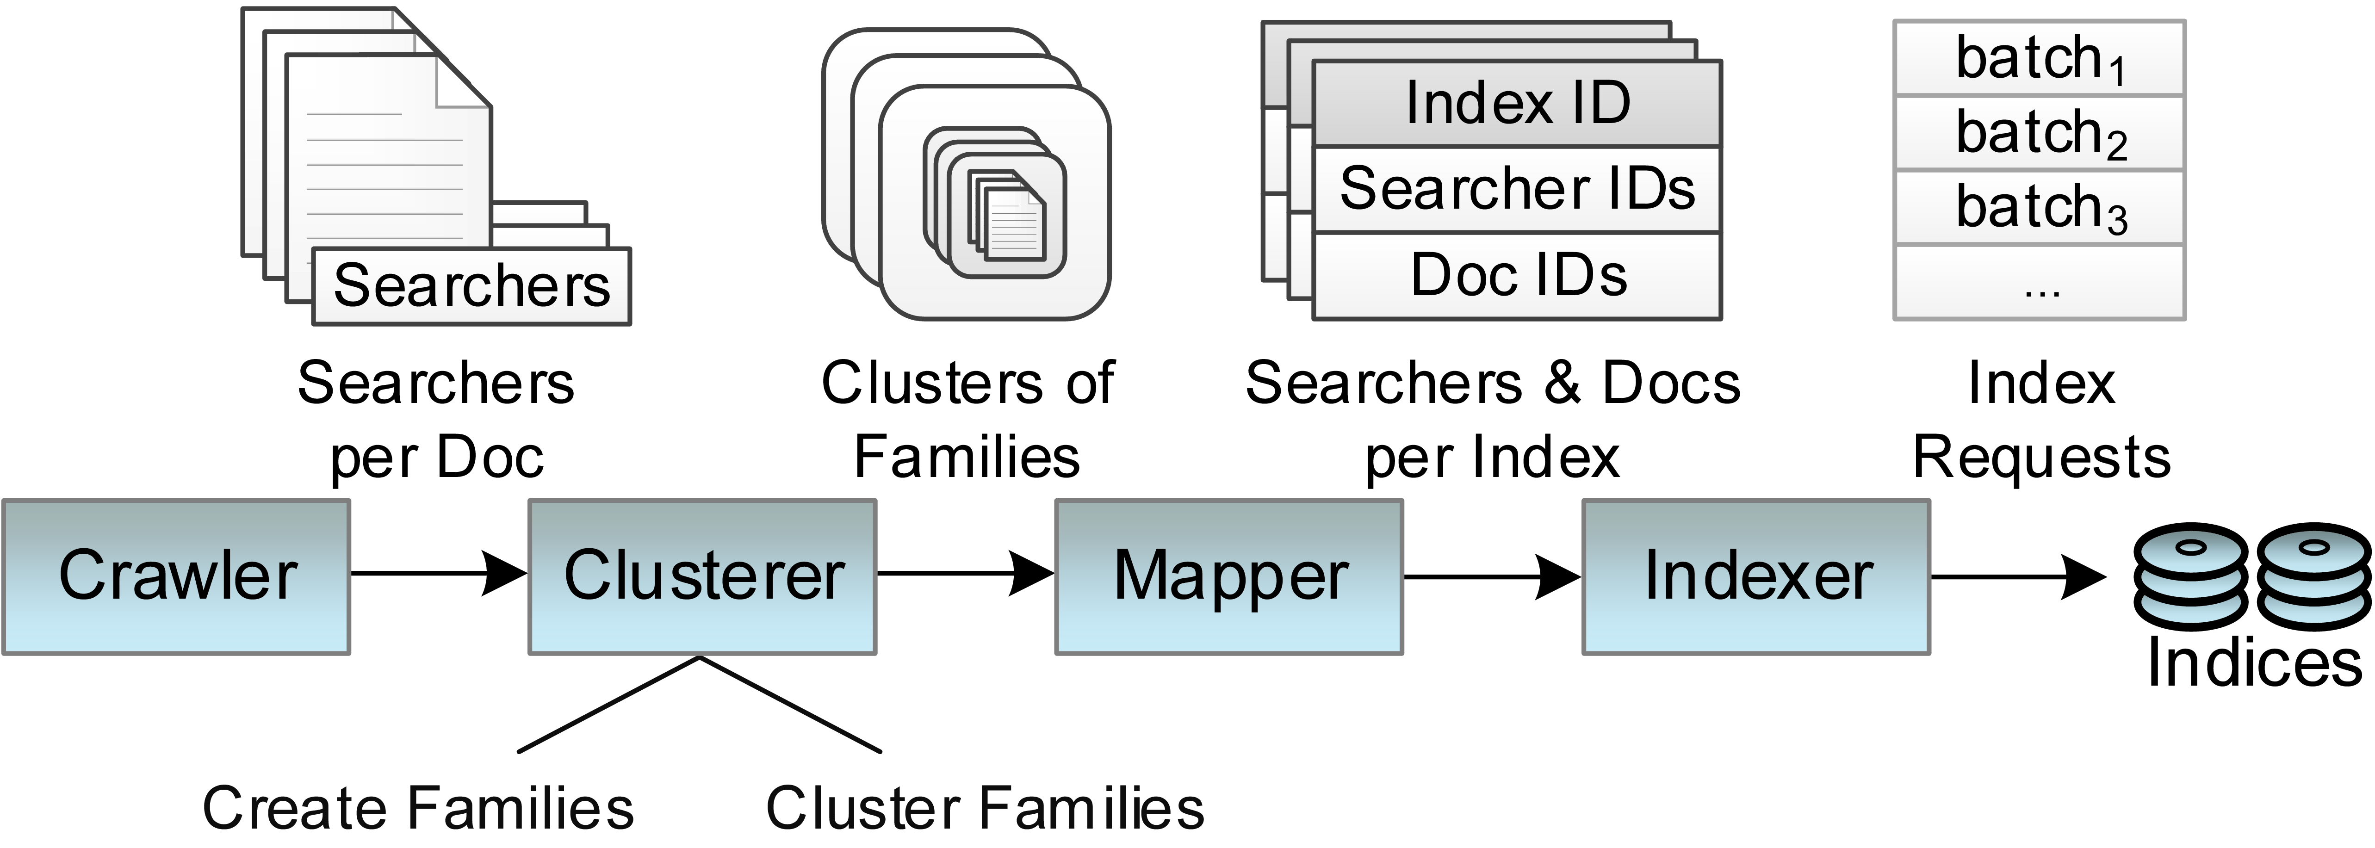
Prototype Implementation
Indexer
receive index specifications from mapper
split documents of each index into batches
communicate with search engine to index documents

Slide 37
Experimental Evaluation
Experimental set up
Linux v2.6.32
quad-core x86 2.33GHz processor
4GB RAM
7.2KRPM SATA disks
Synthetic document collection
searcher lists based on existing dataset (Docushare [1])
200 users, 131 groups, 50000 documents
Configurable parameters
searcher similarity L_{s} є [0, 1]
duplication threshold T_{d} є [0, ∞)
[1] Smetters et al. – Symposium on Usable Privacy and Security

Slide 38
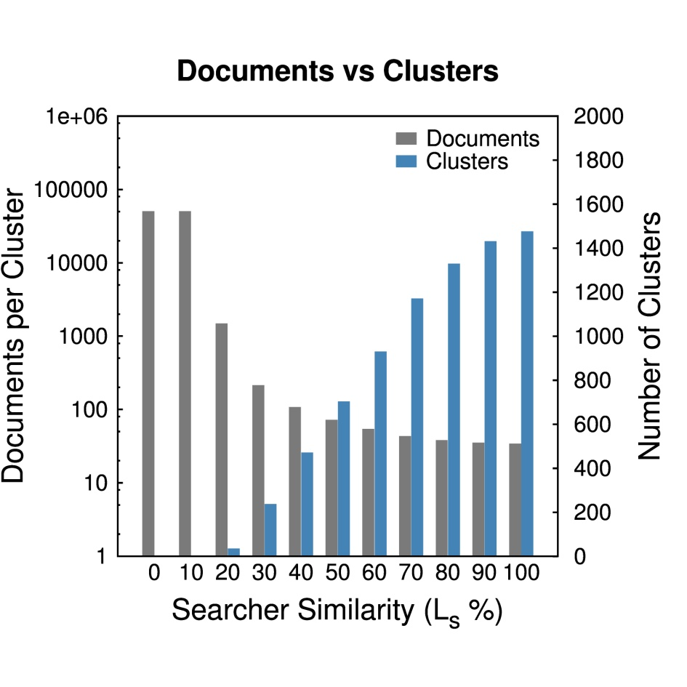
Effect of Searcher Similarity
Noteworthy cases
L_{s} = 0% 1 cluster containing all families
L_{s} = 100% 1 family per cluster
L_{s} = 60% 929 clusters with 53.82 documents each
Lower similarity: fewer and dissimilar clusters

Slide 39
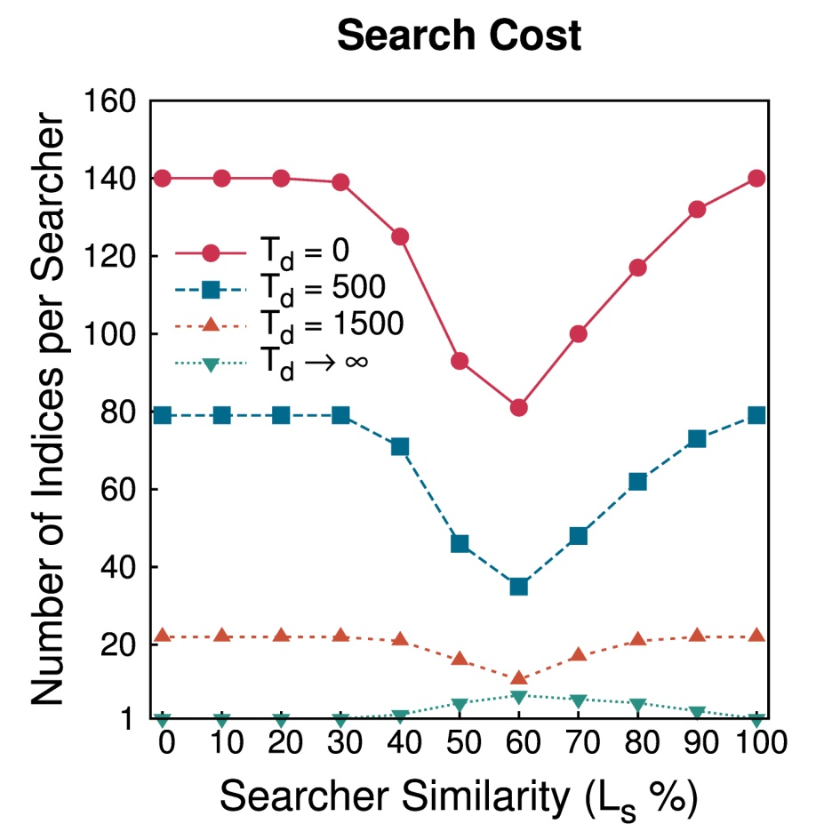
Sensitivity of Search Cost
Indices accessed per searcher’s query
Minimize indices per searcher
T_{d} = 0, 500 or 1500: shared intersection indices at L_{s}= 60%
T_{d} ∞: documents in private indices at L_{s}= 0% or 100%

Slide 40
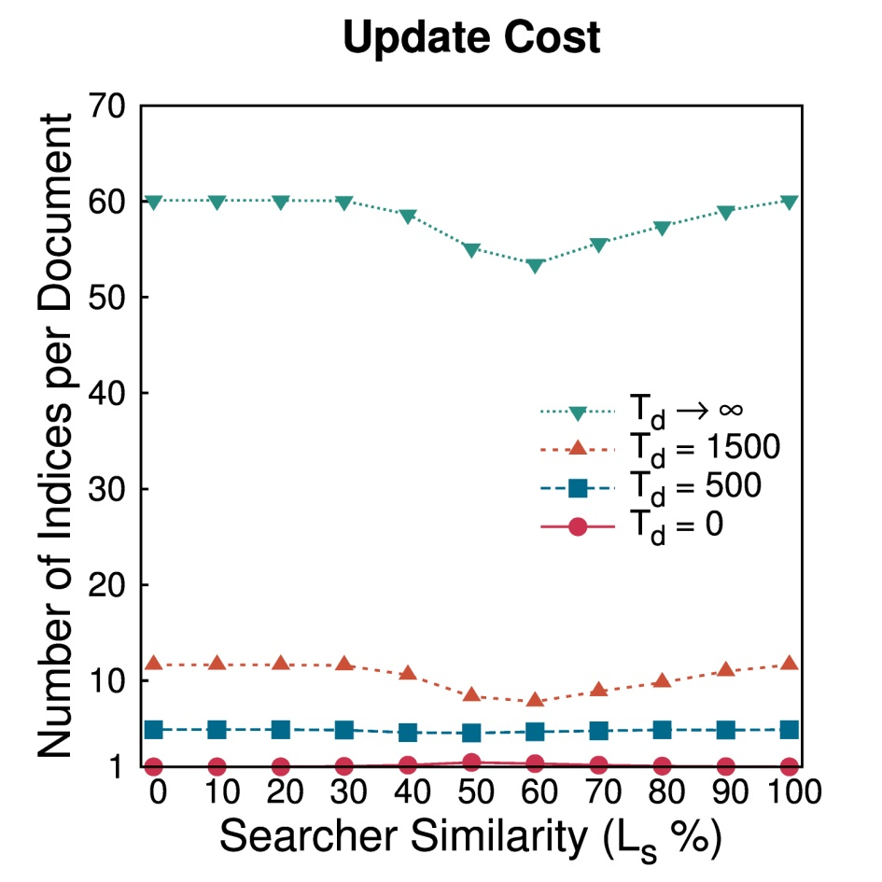
Sensitivity of Update Cost
Indices updated per document
Minimize indices per document
T_{d} = 1500 or ∞: intersections limit document duplication at L_{s} = 60%
Flat curves
T_{d} = 0 or 500 across different L_{s}

Slide 41
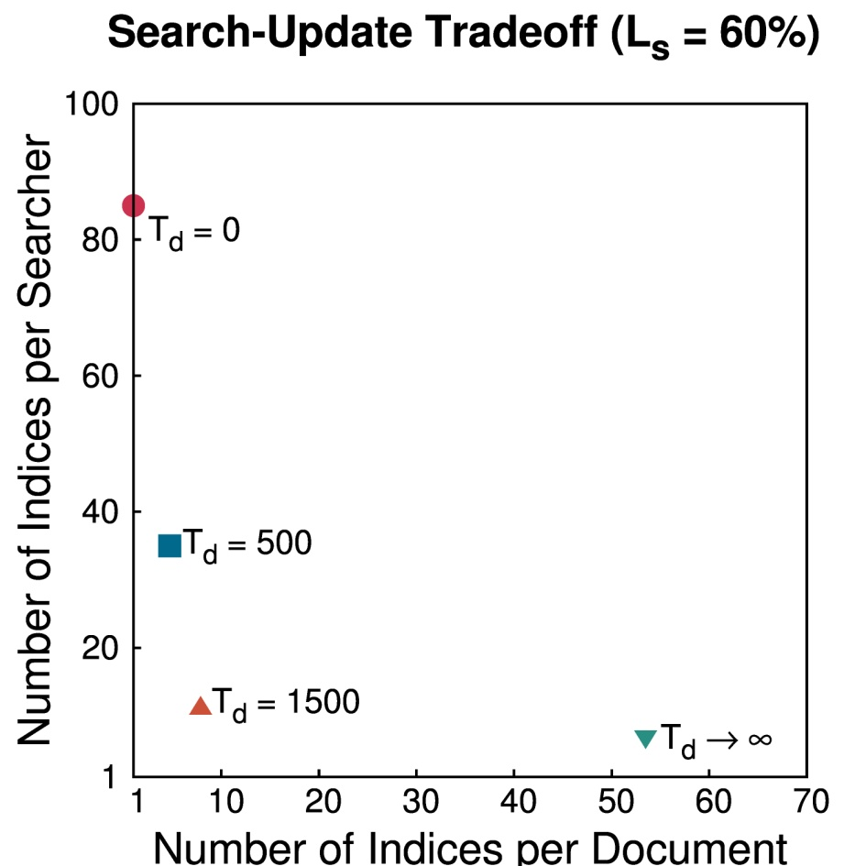
Search-Update Tradeoff
Closer to (1, 1) better
Opposite effect of T_{d}
decreases indices per searcher
increases indices per document
T_{d} = 1500 seems reasonable choice
leads to both low search and update cost

Slide 42
Conclusions & Future Work
Core idea
cluster documents by searcher sets
shared indices for common searchers
Performance analysis
avoided result filtering
reduced indices per searcher
prevented excessive document duplication
Secure and efficient keyword search
tunable parameters achieve low search and update cost
Future work
experiment with broad collection of datasets (e.g., OSN)
integrate Lethe into distributed search engine

