Slide 1
Privacy Risk in Anonymized Heterogeneous Information Networks (How to Break Anonymity of the KDD Cup 2012 Dataset)
Aston Zhang¹, Xing Xie², Kevin C.-C. Chang¹
Carl A. Gunter¹, Jiawei Han¹, Xiaofeng Wang³
University of Illinois at Urbana-Champaign¹
Microsoft Research²
Indiana University at Bloomington³

Slide 2
K-Anonymity
Any tuple can be re-identified with a probability no higher than 1/K
AAABBB, 3-anonymity
AABBBB, 2-anonymity
ABBBBB, 1-anonymity

Slide 3
K-Anonymity?
If the adversary (attacker) is only interested in breaking privacy of tuples with value B…
AAABBB, 3-anonymity
AABBBB, 4-anonymity?
ABBBBB, 5-anonymity?

Slide 4
Limitations of K-Anonymity
T₁₀₀₀ (1000 tuples of the same value: AAA…AA): 1000-anonymity
T₂ (500 pairs of same values: AABBCCDD…): 2-anonymity
Consider injecting a globally unique tuple t*
T₁₀₀₀* (1000 same tuples: AAAAAA…AAAA t*)
T₂* (500 pairs of same values: AABBCCDD…t*)
Are their security level really the same in terms of k-anonymity?
Both: 1-anonymity

Slide 5
K-Anonymity: Worst Says All

Slide 6
Different Individuals May Have Different Privacy Needs

Slide 7
Our Proposed Privacy Risk
Individual Privacy Risk – Allow us to differentiate!
Aggregate Individual Privacy Risk to obtain Dataset Privacy Risk
Mathematical Factor
Social Factor

Slide 8
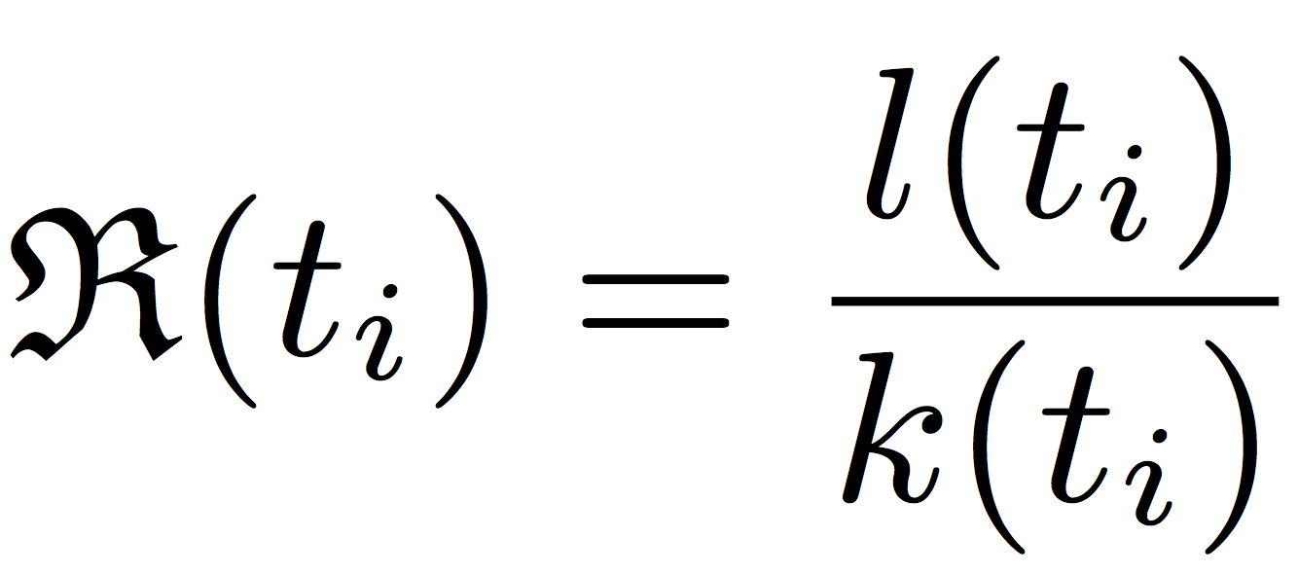
Our Proposed Privacy Risk
Privacy risk of tuple t_{i} in dataset T:
Privacy risk of dataset T:
Individual Privacy Risk
l(t_{i}): loss function (social component)
k(t_{i}): the number of tuples in T with the same value of t_{i} (math component)
Dataset Privacy Risk
N: the size of dataset T (the number of tuples in T)

Slide 9
Expected Privacy Risk
Lemma 1: Given dataset T with cardinality C(T), for each tuple t_{i} in T, assuming the loss function is independent of 1/k(t_{i}) with mean value μ, the expected privacy risk

Slide 10
Privacy Risk of Dataset
Theorem 1: The privacy risk R(T) of dataset T is
Cardinality of T
Size of T
^{N: the number of tuples in T}
C(T): cardinality of T —— number of distinct (combined) attribute values describing tuples
^{T=ABCDE: C(T)=5, R(T)=1}
^{T’=AAAAA: C(T’)=1, R(T’)=1/5}
^{T’’=AAA: C(T’’)=1, R(T’’)=1/3}

Slide 11
Privacy Risk = C(T)/N, Better Interpretation
T₁₀₀₀ (1000 same tuples: AAAAAA…AAAA)
1000-anonymity (Privacy Risk: 1/1000)
T₂ (500 pairs of same values: AABBCCDD…)
2-anonymity (Privacy Risk: 500/1000)
Inject globally unique tuple t*
T₁₀₀₀* (1000 same tuples: AAAAAA…AAAAt*)
1-anonymity (Privacy Risk: 2/1001)
T₂* (500 pairs of same values: AABBCCDD…t*)
1-anonymity (Privacy Risk: 501/1001)
R(T₁₀₀₀*) < R(T₂*)

Slide 12
How Bad Is Our Privacy in HIN?
Heterogeneous Information Networks (HIN)

Slide 13
We Live In a More Connected World
Heterogeneous Information Networks (HIN)
Multiple types of entities (nodes) or links (edges)
Present in
social media (Twitter)
medical information systems (EMR)
academic information systems (DBLP)
and more…

Slide 14
Heterogeneous Information Networks in Social Media (KDD Cup 2012 Dataset)

Slide 15
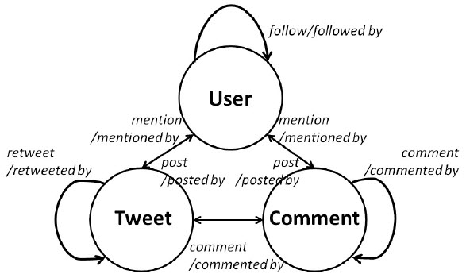
Network Schema

Slide 16
Meta-Paths

Slide 17
Attribute-Metapath-Combined Values of Target Entities
The neighbors of the target entity A1X are generated along target meta paths

Slide 18
Attribute-Metapath-Combined Values of Target Entities
Theorem 2: For power-law distribution of the user out-degree, the lower and upper bounds for the expected heterogeneous information network cardinality grows faster than double exponentially with respect to the max. distance of utilized neighbors.
Privacy Risk = C(T)/N

Slide 19
Privacy Risk Increases With More Link Types

Slide 20
Privacy Risk Increases With More Link Types

Slide 21
DeHIN Algorithm to Prey on Privacy Risk in HIN

Slide 22
DeHIN Algorithm to Prey on Privacy Risk in HIN

Slide 23
Break Anonymity of the KDD Cup 2012 Dataset
Profile
Gender
Year_of_birth
as
rs
cs
No_of_Tags
f
No_of_tweets
a
r
c
Profile
Profile
Profile
Profile
Advantages: Exploit the identified privacy risk without requiring creating new accounts or relying on easily-detectable graph structures in a large-scale network [BDK’07, NV’09]

Slide 24
Experiments – The Existing Defense
Modified based on [Wu and Ying’11]

Slide 25
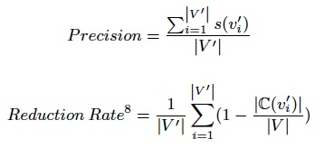
Experiments – Key Measures

Slide 26
DeHIN Performs Better on Denser Networks by Utilizing Longer-Distance Neighbors

Slide 27
DeHIN Performs Better with More Link Types

Slide 28
DeHIN’s Performance Slightly Degrades When Anonymity Gets Stronger

Slide 29
DeHIN Performs Better with More Link Types

Slide 30
Privacy Risk Increases With More Link Types

Slide 31
The Research Roadmap

