Slide 1
CLUDE: An Efficient Algorithm for LU Decomposition Over a Sequence of Evolving Graphs
Chenghui Ren, Luyi Mo, Ben Kao, Reynold Cheng, David Cheung
The University of Hong Kong
{chren, lymo, kao, ckcheng, dcheung}@cs.hku.hk
Notes:
Good afternoon, every one! Welcome to my oral defense. Today I am going to present my thesis titled ***.

Slide 2
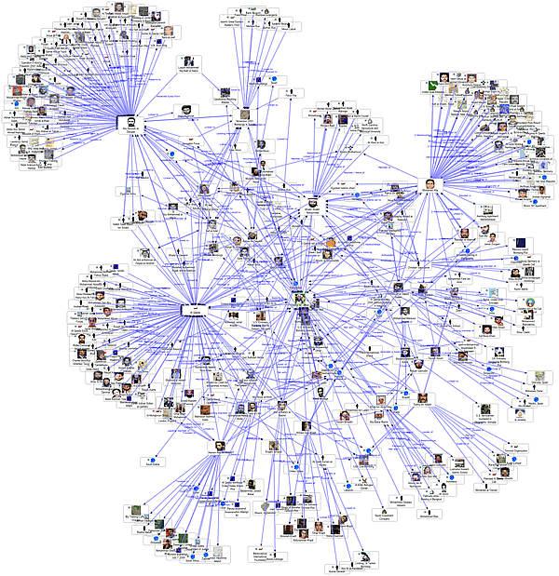
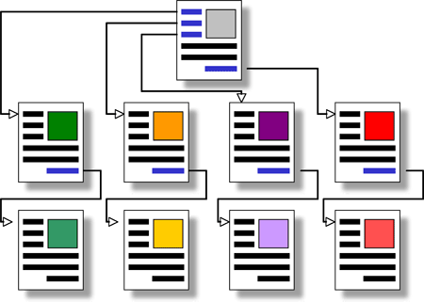
Modeling the World as Graphs
Social networks
Web
Notes:
Graphs are widely used to model the world. For example, a graph can be used to model a social network for which users are represented by nodes while their friendships are represented by edges.
A graph can also model web pages and the hyperlinks connecting them.
Graphs are very useful in modeling relationships between objects. For example, it can model a social network, or webpages.

Slide 3
Graph-based Queries
PageRank
Measures of the importance of nodes
SALSA
Personalized PageRank
Random Walk with Restart
Measures of the proximities between nodes
Discounted Hitting Time
Notes:
A number of queries have been proposed for analyzing graph structures. Examples include PR and SALSA, which measure the importance of nodes, PPR, DHT and RWR which measure the proximities between nodes. These measures have extensive applications. For example, Google employs PR to rank search results and PPR is often used in node clustering and community detection.
People have defined many measures on graph structures. These measures can be divided into two categories. For example, xx, xx measure how well a node is compared to the others in the graph; and xx, xx, and xx are proximity measures between nodes.

Slide 4
Introduction
PR SALSA PPR DHT RWR
A common property: Computing them requires solving linear systems
# of nodes in the graph: n
A: n x n matrix, captures the graph structure
x: vector of size n, gives the measures of the nodes in the graph
b: vector of size n, depends on the measures computed, input query vector
Notes:
A comment property of these measures is that compute them requires solving certain linear systems of the form Ax = b,
where A depends only on the graph structure and the kind of measure, and b in an input query for a measure.
A common property of them is that computing them can be reduced to solve certain linear systems.
Suppose

Slide 5
Example: Random Walk with Restart RWR
2
4
u
3
With a probability d, transit to a neighboring node
With a probability (1-d), transit to the starting node
x (v) steady-state probability that we are at node v
A: derived from the graph
x: RWR scores
b: RWR with starting node 1
Notes:
Take the RWR measure as an example.
We start from a node u in a graph and at each step transit to another node. Specifically, with a probability d, we transit to a neighboring node via an edge, and with a probability (1-d), we transit to the starting node u.
The RWR score of a vertex v is the steady-state probability that we are at node v.
Intuitively, a large score of v implies that v is close to node u under the RWR measure.
In this example, the RWR score of each node can be determined by solving this linear equation.
The matrix A derives from the graph and the factor d in the measure.
The vector b represents the RWR measure with starting node 1
Solving this equation we will get the measure of each node as vector x.
How to compose the matrix, the vector, and solve the linear system has been well studied for a single graph.

Slide 6
Graphs Evolve over Time
Information modeled by graph changes over time.
measure → measure → measure → measure → …
…
Time
Evolving Graph Sequence (EGS) [VLDB’11]
Notes:
But in practice, the graph is not static.
The information modeled by graph changes over time. For example, a hyperlink is added to a webpage, or a facebook link between two friends is established. Hence, the graph evolves with time.
In our earlier work in VLDB’11, we proposed to manage and analyze the evolving graphs as an EGS. It’s a sequence of snapshot graphs, each of which captures the graph’s structure at a particular time.
As a graph derives a matrix, from which various measures can be computed. The graph evolves over time, so are the matrix and measures. If one want to keep track of the evolving measures, she need to compute the measures over the whole EGS.

Slide 7
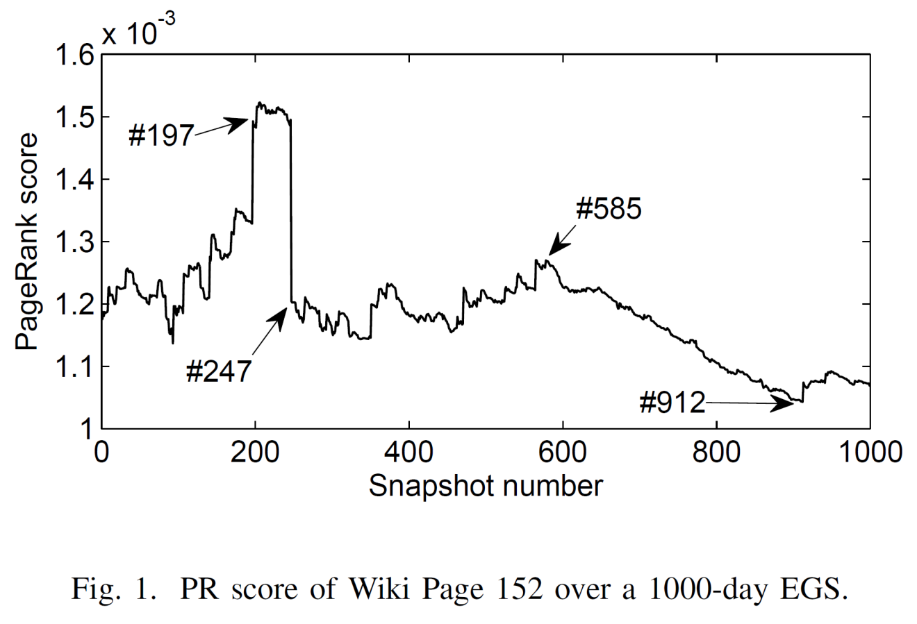
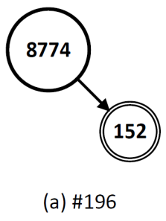
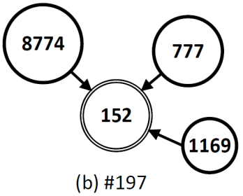
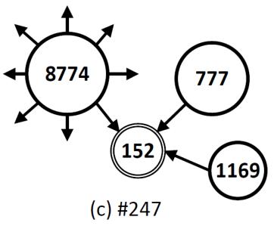
Example: PR Score Trend Analysis
Wikipedia,
20,000 Wiki pages,
1000 daily snapshots
Key moments:
PR score changes significantly
Notes:
Let us take a look at a motivating example which shows that measures over an EGS may lead to interesting analysis.
Pagerank is widely used in measuring the importance of a hyperlinked webpage.
To illustrate how the pagerank score evolves over time, we have collected 1000 daily snapshots for 20,000 wiki pages.
This figure shows the pagerank score of a page labeled 152.
It goes up and down in these 1000 days.
Suppose we want to discover any special event occurs in the graph structure which leads to changes of its pagerank score.
In order to do that, an approach is to compute its score at every snapshot, and plot it as a curve like this figure.
From it, we see a number of key moments where the score changes significantly, such as a sharp rise at #197, and a rapid decline at #247.
With these key moments, we can focus our investigation over a manageable set of snapshots but not all of them.
Let us discuss some key moments and the underlying graph structure at that time.
We use a node to represent a page with certain label, and the size of the node represents how large its pagerank score.
To see why there is a sharp rise at #197, we take a look at the graph structure at these two snapshots.
We see two links are added to the page from two other pages of high scores. These two pages contributed much to the rise of 152’s score.
But at snapshot 247, a high-score page, which only pointed to 152 before, was edited with 30 new more outgoing links. This significantly reduce its contribution to 152’s score.
From this example, we see that, to discover these interesting events, measures are required to be evaluated at each snapshot in the evolving graph sequence.

Slide 8
Evolving Matrix Sequence (EMS)
Evolving Matrix Sequence (EMS)
Objective: efficiently compute
various measures over an EMS
Notes:
Let us now formally introduce our problem.
As a graph derives a matrix, an EGS derives an EMS.
And our main objective is to study how to efficiently compute various measures over an EMS

Slide 9
Challenges
many A’s
Each matrix in the EMS
1 year daily snapshots → 365 A’s
many b’s
RWR score between any two nodes → n b’s
LU decomposition
Notes:
As we mentioned, for various measures, a common approach is to solve some linear systems. So in this slide, let me talk more about the challenges to solve the linear systems in the EMS.
Actually, there are two problems. First is the problem of many b’s. For instance, if we want to get the proximities between every two nodes in the graph under the RWR, then we will have n different input vector b for n different starting nodes.
Another one is the problem of many A’s. As we mentioned, we need to get the measures for every matrix in the sequence. So if we have a 1 year daily snapshots, then we have to solve the linear system for 365 A’s.
Let’s first talk about how to solve the problem of many b’s. A standard method is to do LU decomposition.

Slide 10
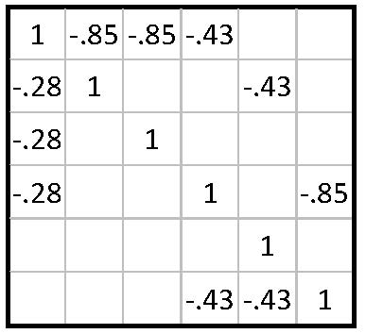
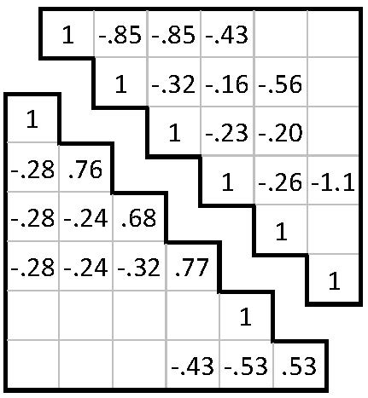
LU Decomposition (LUDE)
LU factors
Forward & backward substitutions
Solving LUx₁ = b₁
Much faster than LU
Solving LUx₂ = b₂
Solving LUx_{q} = b_{q}
Notes:
LU decomposition first decomposes the matrix A as a product of a lower triangular matrix and an upper triangular matrix U. Although LU decomposition is a rather expensive operation to a large graph, once the matrix A is decomposed, all linear systems can be solved very efficiently using forward and backward substitutions, which are much faster than LU. Using LUDE allows us to solve the problem of many different input b’s.

Slide 11
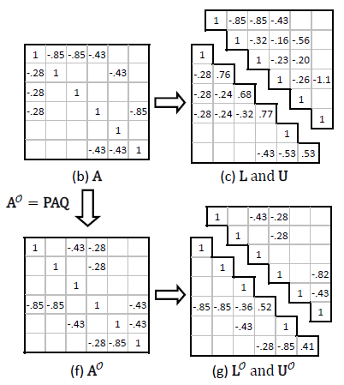
Fill-ins in LUDE
#fill-ins: 8
(fill-in: An entry that is 0 in A but becomes non-zero in L and U)
More fill-ins will cause:
More space to store (L, U)
More time to do forward/backward substitutions in solving LUx = b
More time to do LU decomposition
Notes:
But there is a performance issue in LUDE.
It may introduce some fill-ins, which are the zero entries in A, but non-zero entries in L and U.
For this example matrix, the red boxes are the fill-ins. And there are 8 fill-ins in total.
A large number of fill-ins is undesirable because it takes more space to store LU matrices and it slows down the forward/backward substitutions in solving the linear systems. And It increases the decomposition time.

Slide 12
Preserving Sparsity in LUDE: Matrix Reordering
#fill-ins: 8
(fill-in: An entry that is 0 in A but becomes non-zero in L and U)
#fill-ins: 1
Notes:
A common approach to reduce #fill-ins is to apply a reordering technique, which shuffles the rows and columns of a matrix before the matrix is decomposed. For example, if we reorder the matrix into this form, the #fill-ins is reduced from 8 to 1.

Slide 13
Preserving Sparsity in LUDE: Matrix Ordering
Finding the optimal ordering to minimize #fill-ins is NP-complete
Effective heuristic reordering strategies
Markowitz
AMD
Degree
…
Most effective
Notes:
Although finding to the optimal ordering of a matrix to minimize #fill-ins is an NP-complete problem, there are a few heuristic reordering strategies such as Markowitz and AMD which have been shown to be very effective in reducing the #fill-ins in practice. And the Markowitz one is the most effective among these strategies. But in some cases, geting the ordering is computationally similar with doing an LUDE.

Slide 14
Challenges
many A’s
Each matrix in the EMS
1 year daily snapshots → 365 A’s
many b’s
RWR score between any two nodes → n b’s
LU decomposition for all A’s
LU decomposition
+
+
Reordering for all A’s
Reordering
Notes:
As we use LUDE and reordering techniques to solve the problem of many b’s, for the problem of many A’s, we need to LU decompose all A’s as well as getting ordering for them.

Slide 15
LUDE over an EMS (LUDEM) Problem
How many orderings should be computed?
T orderings?
1 ordering?
Others?
The EMS gradually evolves over time:
successive graphs in Wiki share 99% of edges
Can we apply incremental methods?
Notes:
We now formal this problem as the LUDE over an EMS in this page.
Given an EMS, where each matrix is derived from a snapshot graph in an evolving graph sequence.
We need to determine an ordering for each matrix, and compute its LU factors.
This problem has two hidden requirement. First, we want to get a good ordering. An immediate question is how many orderings should we compute? One extreme case is to compute one ordering, and apply to all matrices. Another case is to compute an ordering for each matrix.
Another requirement is to get the LU factors fast. As we observed from our wiki dataset, the ems is gradually evolving over time. The successive graphs share more than 99% of edges. This observation inspires us to apply some incremental LU decomposition methods to fast compute the LU factors.
Let us now discuss our solutions.

Slide 16
Brute Force (BF): T orderings
Markowitz orderings
best ordering quality but slow
Notes:
The first one is Brute Force, which employs an extreme ordering strategy, and cetermines the Markowitz ordering O*I for every matrix. Then it decomposes the reordered matrix.
This Brute Force achieves the best ordering quality since the Markowitz ordering is the most effective one.
But it’s generally slow because it takes much time to determine the orderings of all matrices and since we apply different orderings for different matrices, we cannot employ a fast incremental algorithm in Brute Force.

Slide 17
Straightly Incremental (INC): 1 ordering
bad ordering!
Bennett‘s Incremental LUDE [1965’]
Notes:
Another extreme strategy is to do the straightly incremental LUDE for all the matrices in the sequence.
We first determines the Markowitz ordering for the first matrix. Then we apply it to all matrices in the sequence. After that we do a complete LUDE for the first reordered matrix. But for the rest of the matrices, we apply the Bennett’s incremental LUDE. Specifically, we use the updated matrix, as well as the LU factors of the first matrix to compute the lu factors for the second matrix. Here, we use the pink arrow to represent the incremental LUDE. We repeat this process to the last matrix in the sequence.
An issue of this straightly incremental method is that, although the ordering is the best one for the first matrix, it may become a very bad ordering for the last matrix, since the matrix progressively deviates from the first matrix.
The brute force method determines the Markowitz ordering O*I of each matrix , reorders Ai to the Markowitz ordered and then decomposes the reordered matrix.
This method is generally slow because it takes much time to determine the orderings of all matrices and it does not employ a fast incremental decomposition algorithm.
However, BF achieves the best ordering quality because all matrices are Markowitz ordered.

Slide 18
Cluster-based Incremental (CINC)
Cluster 1
Cluster M
Tradeoff between good ordering and fast incremental LUDE
Notes:
In order to solve this problem, we propose a cluster-based incremental methods. It first groups the similar matrices into a cluster, and then apply the straightly incremental method to each of the cluster.
So, for each cluster, we only need to determines one ordering, and do one complete LUDE, and get other LU factors using incremental LUDE.
If the matrices within a cluster are sufficiently similar with each other, it’s easier for us to find one ordering which fits all the matrices. And therefore, this method deals with the tradeoff between finding a good ordering, and applying the fast incremental LUDE.

Slide 19
Overhead of Structural Change
Adjacency-lists structures
Zooming in
1. Structure allocation to store LU factors
2. Numerical computation
70%
Bennett’s incremental LU
Notes:
Let us take a further look at the incremental LUDE.
The LU factors are sparse, therefore, adjacency list structures are used. The adjacency list structures for LU factors of two matrices are different. Therefore, the first step of applying Bennett’s incremental algorithm is to allocate structures to store LU factors, and then the numerical computation.
We have profiled the execution of Bennett’s algorithm. Interestingly, about 70% of its execution time is spent on allocating list structures. This observation motivates us to optimize this overhead of structural changes.

Slide 20
Solution: Universal Static Structure
Cluster
Universal Static Structure
(Able to accommodate non-zero entries of LU factors of all matrices in a cluster)
Notes:
Here is our solution. We constructs Acup which is conceptually the union of all the matrices in the cluster, and decompose it.
A universal static structure can be obtained from the LU factors of this matrix. This structure is shown to be able to accommodate the nonzeros of the LU factors of all matrices in the cluster.
Bennett’s algorithm can then executed on the static structure.

Slide 21
Solution: Universal Static Structure
Cluster
Universal Static Structure
(Able to accommodate non-zero entries of LU factors of all matrices in a cluster)
Notes:
Similarly, we can also determines the ordering based on this Acup, so that the ordering can cover all matrices in the cluster.

Slide 22
CLUDE: Fast Cluster-based LU Decomposition
Cluster 1
Cluster M
with static structure
No structural change overhead, better ordering quality
Notes:
We combine all these techniques together to get our fast cluster-based lu decomposition methods, which is called CLUDE.
It first groups similar matrices into clusters. It then compute the union of matrices in a cluster, and determines its Markowitz ordering, which is further applied to all matrices in this cluster. After a complete LUDE, incremental LUDE is applies.
The highlight of this CLUDE is there is no structural change overhead, and it potentially gives a better ordering quality.

Slide 23
Experimental Setup
Datasets
Two real datasets (which derive two EMS’s)
Wiki (pages and their hyperlinks) default
DBLP (authors and their co-authorships)
Synthetic EMSs
Settings
Java, Linux, CPU: 3.4GHz Octo- Core, Memory: 16G
Dataset | #snapshots | |V| | |E₁| | |E_{last}|
Wiki | 1000 | 20,000 | 56,181 | 138,072
DBLP | 1000 | 97,931 | 387,960 | 547,164
Notes:
We run experiments to evaluate the algorithms on both real datasets and synthetic datesets

Slide 24
Evaluation of a Solution
Ordering quality
Quality-loss of an ordering O of A:
Efficiency
Speedup over BF’s execution time
# of extra fill-ins
O*: Markowitz ordering of A
Notes:
We evaluate solutions in two aspects, the ordering quality and efficiency.
The quality of an ordering is measured by the quality loss of O with respect to the Markowitz ordering.
The numerator of the quality loss is the extra fill-ins of O ordering compared with the Markowitz ordering. A smaller number of extra fill-ins implies the less quality loss, and so the better ordering quality.
We express algorithms’ efficient in terms of their speedup over BF’s execution time.

Slide 25
Ordering Quality: Inc
Snapshot #
Snapshot number
INC applies Markowitz ordering of A1 to all matrices in the whole EMS
Notes:
We first take a look at the straightly incremental methods.
The x-axis is the snapshot number in the sequence, and the y-axis is the quality loss. Recall that the straightly incremental method applies the Markowitz ordering of the first matrix to all other matrices. Since the matrix progressively deviates from the first matrix, the quality-loss decreases with the snapshot number.
Indeed, the ordering quality of INC is quite poor. For wiki, the average quality loss is about 2, which means on average the number of extra fill-ins using the straightly incremental method is twice of the non-zero entries in LU factors using the Markowitz ordering.

Slide 26
Ordering Quality: CINC, CLUDE
CINC applies Markowitz ordering of A1 to all matrices in the cluster
CLUDE applies Markowitz ordering of A_{U} to all matrices in the cluster
Notes:
By grouping similar matrices into a cluster an applying the same ordering only to matrices of the same cluster, CINC and CLUDE give much better ordering qualities.
X-axis blablabla, which controls the tightness of a cluster. Intuitively, a larger alpha implies a tighter cluster. y-axis blablabla.
The figures show the average quality loss of the ordering given by CINC and CLUDE as the similarity threshold alpha varies.
Comparing CINC and CLUDE, CLUDE gives much better ordering qualities. This is because while CINC uses the Markowitz ordering of the first matrix in the cluster, CLUDE uses the Markowitz ordering of the union matrix, which covers all matrices in the cluster and thus fits them better.

Slide 27
Efficiency
Reasons of the big gap between CLUDE and CINC:
(1) CLUDE gives better ordering quality
(2) CLUDE uses static data structures for storing the matrices’ LU factors
Notes:
Next we compare the algorithms in terms of speed. We express algorithms’ efficiency in terms of their speedup over BF’s execution time.
The main result is that CLUDE is much better than other solutions, and it registers about 15-20 times speedup over the BF’s execution time. There are two factors for this significant speedup. One is that CLUDE gives better ordering quality which leads to smaller LU factors and thus faster decomposition time.
The other is that CLUDE uses the static data structures for storing the matrices’ LU factors.

Slide 28
Synthetic Dataset
General observation:
CLUDE gives the best ordering quality,
at the same time is much faster than INC and CINC

Slide 29
Related Work
EGS processing
Computation of shortest path distance between two nodes across a graph sequence
Computation of various measures (PR/SALSA/PPR/DHT/RWR) on single graphs
Approximation methods (power iteration, Monte Carlo)
Two order of magnitude faster if A is decomposed
Sparse matrix decomposition
Maintaining measures incrementally
Approximation methods
An order of magnitude faster
Graph streams
How to detect sub-graphs that change rapidly over small window of the stream
Graphs that arrive in the stream are not archived

Slide 30
Conclusions
We studied the LUDEM problem
Interesting structural analyses on a sequence of evolving graphs can be carried out efficiently
We designed CLUDE for the LUDEM problem based on matrix ordering and incremental LU decomposition
CLUDE outperformed others in terms of both ordering quality and speed

Slide 31
Q & A
Thank you!
Contact Info: Luyi Mo University of Hong Kong lymo@cs.hku.hk http://www.cs.hku.hk/~lymo

Slide 32
Our Solutions
many A’s
many b’s
LU decomposition for all A’s
LU decomposition
BF: T orderings (1 ordering for 1 matrix)
best ordering, slow
CLUDE: cluster-based, static structure
good ordering, fastest
CINC: cluster-based
good ordering, fast
INC: 1 ordering
(for all matrices)
bad ordering, slow
Notes:
Here is the summary of our solutions to solve the problem of many A’s.
For the brute force, it gives the best ordering, but it’s slow since it need to compute the ordering for each matrix.
For straightly incremental methods, it produces bad orderings, and so it’s also slow.
The cluster-based incremental methods can give a good ordering, and runs faster than the last two methods.
And our CLUDE uses the static structure to avoid the overhead of structural changes, so it’s the fastest one, and also gives good ordering quality.

Slide 33
Example2: Analysis of Actions to Improve PR Score
Translating the web page
Publicizing the web site through newsletters
Google official guide
Providing a rich site summary
…
How to evaluate the effectiveness of these actions?
Actions taken
Changes to PR score
Notes:
In Google's official guide on improving a web page’s PR scores, a number of actions are recommended. Some of these actions include **, ** and so on. How shall we evaluate the effectiveness of these actions? To answer this question, we need to analyze the association between various actions taken and any observable changes to the measure. This again requires the PR score to be computed at every snapshot in the EGS.

Slide 34
Clustering Algorithm
EMS
Segmentation clustering algorithm:
A cluster consists of successive snapshots
A cluster satisfies:
Notes:
Now we discuss how to group snapshots into clusters. Since an EGS models the continuous evaluation of a graph, we use a simple segmentation strategy. We start with an empty cluster and incrementally insert the snapshots starting with G1, then G2 and so on until a certain bounding requirement is violated, we start building the next cluster and repeat the process.
The bounding requirement is that the graph edit similarity between the two representative graphs Gcap and Gcup is at least alpha.

Slide 35
Future Work
Distributed algorithms
Key moment detection
Key moment of a measure over an EGS: the moment at which the measure score changes dramatically
Notes:
FVF works with a parameter alpha to control the clustering. Although FVF works well over a wide range of alpha values, the performance of FVF varies not unnoticeably with alpha.
To reduce the impact of alpha on FVF, we can try a hierarchal clustering algorithm in preprocessing phase.
Our algorithms work on a single computer and all data are stored in main memory. The graphs are becoming larger and larger, which will make a single computer could not efficiently answer queries and make the graph data unable to fit in main memory.
One possible direction of future work is to extend the algorithms to work efficiently on hard disk or work distributedly.
Key moments of a measure over an EGS are those moments at which the measure score changes dramatically.
People are interested at them.
Currently, to detect key moments, we compute a measure on every snapshot. Another direction of future work is to detect key moments without computing the measure on each snapshot.

Slide 36
LUDEM-QC Problem (For Symmetric EMS)
It can be easily computed for symmetric matrices

Slide 37
Solutions for LUDEM-QC
Key: Control the size of the cluster
The smaller the cluster is, the higher the chance the CINC or CLUDE satisfy the quality constraint
Beta-clustering algorithms are thus proposed

Slide 38
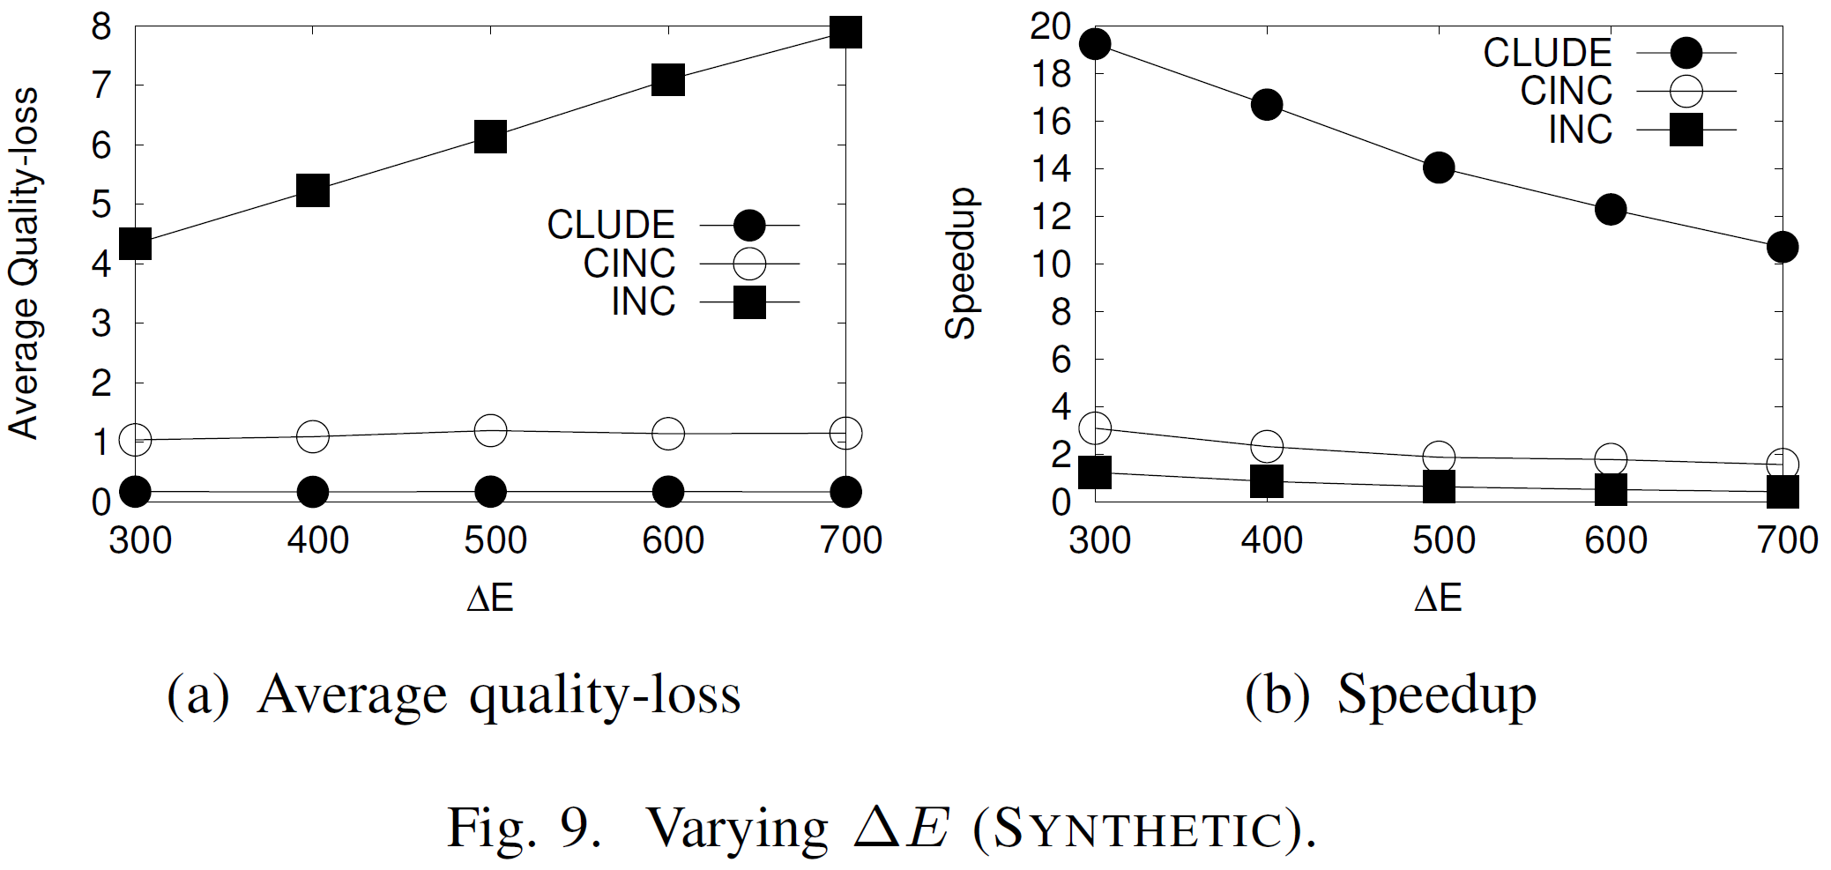
Synthetic Dataset

Slide 39
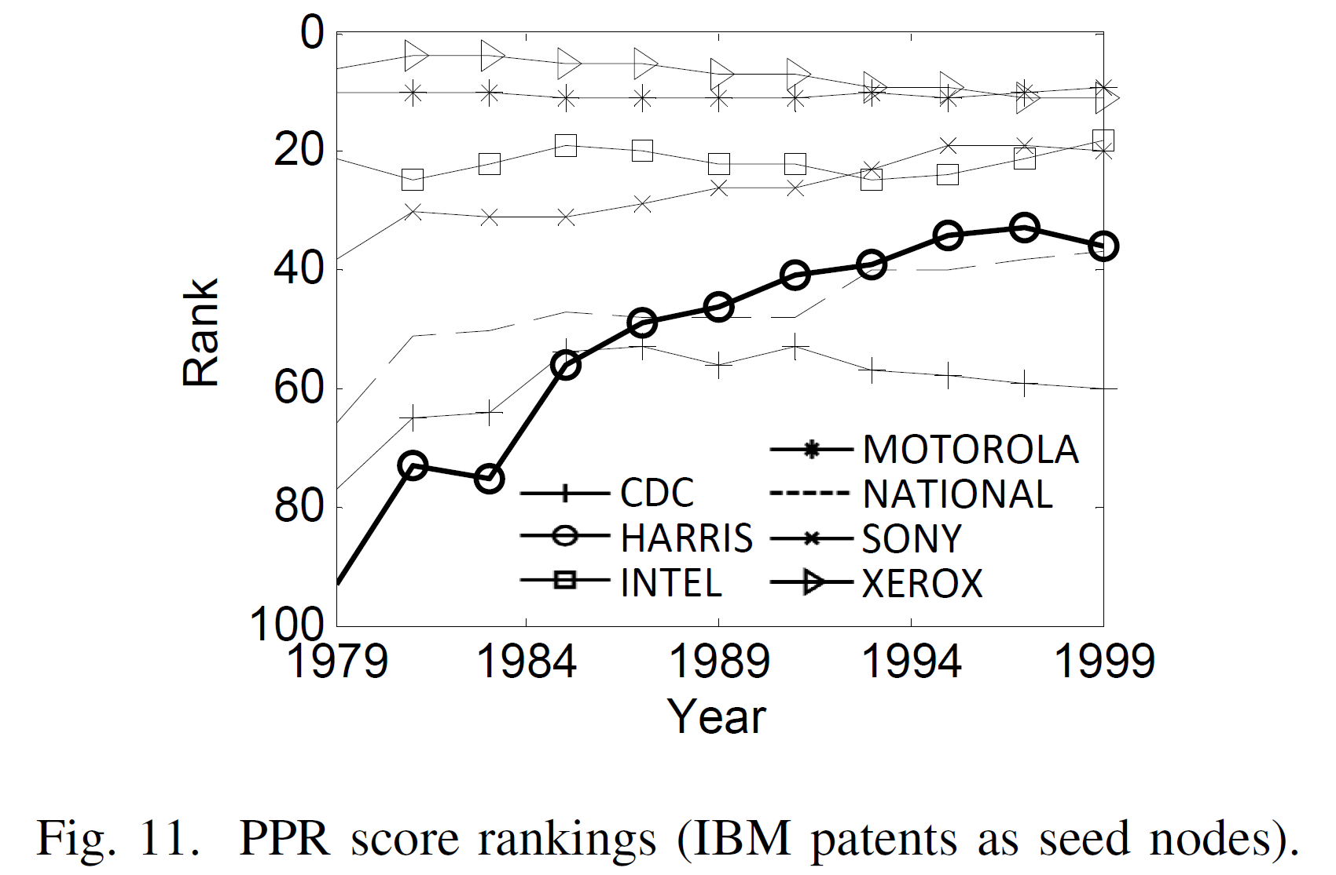
Case Study
In 1992, IBM and HARRIS announced their alliance to share technology
HARRIS’s stock price hit a closing high shortly after the announcement

