Slide 1
Crowdsourcing turning restrictions for OpenStreetMap
MUD 2014, March 28, 2014, Athens, Greece
Alexandros Efentakis, Sotiris Brakatsoulas, Nikos Grivas, Dieter Pfoser
Research Center «Athena» Greece

Slide 2
Introduction
Abundance of GPS tracking data
Significant research around:
GPS trajectories
Map-matching algorithms
Identifying turning restrictions?
In this research effort:
Infer turning restrictions for OpenStreetMap data
Utilizing historic map-matching results
Straighforward & effective way

Slide 3
Importance of turning restrictions
Critical for any fleet management solution
Routing service
Isochrone service
Ignoring traffic:
Suboptimal, yet valid route
Ignoring turning restrictions:
Erroneous paths
May lead to accidents

Slide 4
Importance of turning restrictions
Intersections are important components of urban road networks
Contribute much to the total travel time cost
Intersection delays contribute to 17-35% of the total travel time

Slide 5
Previous works
Previous works on turn costs / intersection delays
Generalization of turning restrictions (turn delays of ∞)
Fundamentally different from our approach:
Previous works |  | Our approach
To calculate turns costs many vehicles need to use the turns |  | Identify restrictions by focusing on turns with no data
Use GPS trajectories |  | Use map-matching results
Data-mining techniques: divide GPS datasets into training and test set |  | Independent mapping service to verify findings
Publicly available datasets: Simulated Focused on specific city Limited time periods |  | Our dataset: Three European cities 2,000-5,000 vehicles per city 12-month period

Slide 6
OSM and turning restrictions (1/2)
OpenStreetMap dataset:
Crowdsourced
High-quality
Frequently updated
BUT: limited information for turning restrictions
Why?
No public datasets for traffic signs
Satellite imagery cannot help
Adding a single restriction is time-consuming

Slide 7
OSM and turning restrictions (2/2)
OSM contains a relation tag
Relation:restriction
Small number of OSM users contribute
Worse for other European countries (e.g., in Montenegro)
Contribution as of September 2013
city | 2009 | 2010 | 2011 | 2012 | 2013 | total
Athens | - | 11 | 1 | 75 | 127 | 214
Berlin | 8 | 26 | 101 | 386 | 147 | 668
Vienna | 33 | 36 | 99 | 307 | 324 | 799

Slide 8
Map-matching
FCD collection from vehicles is now mainstream
GPS trajectories:
Latitude + longitude + timestamp
Imprecise
Measurement errors: limited GPS accuracy
Sampling error
Map-matching (MM):
Aligns GPS positions with the road network graph
INPUT: GPS trajectories
OUTPUT: Ordered sequence of road network graph edges

Slide 9
Using MM results
In scientific literature:
Significant work on processing FCD
No work on processing MM results
Despite being more condensed & less error-prone
We have a large amount of historic MM data
Take advantage of them to identify turning restrictions
How?
Turns allowed in the original data
In practice, rarely, if ever, used
Most probably prohibited

Slide 10
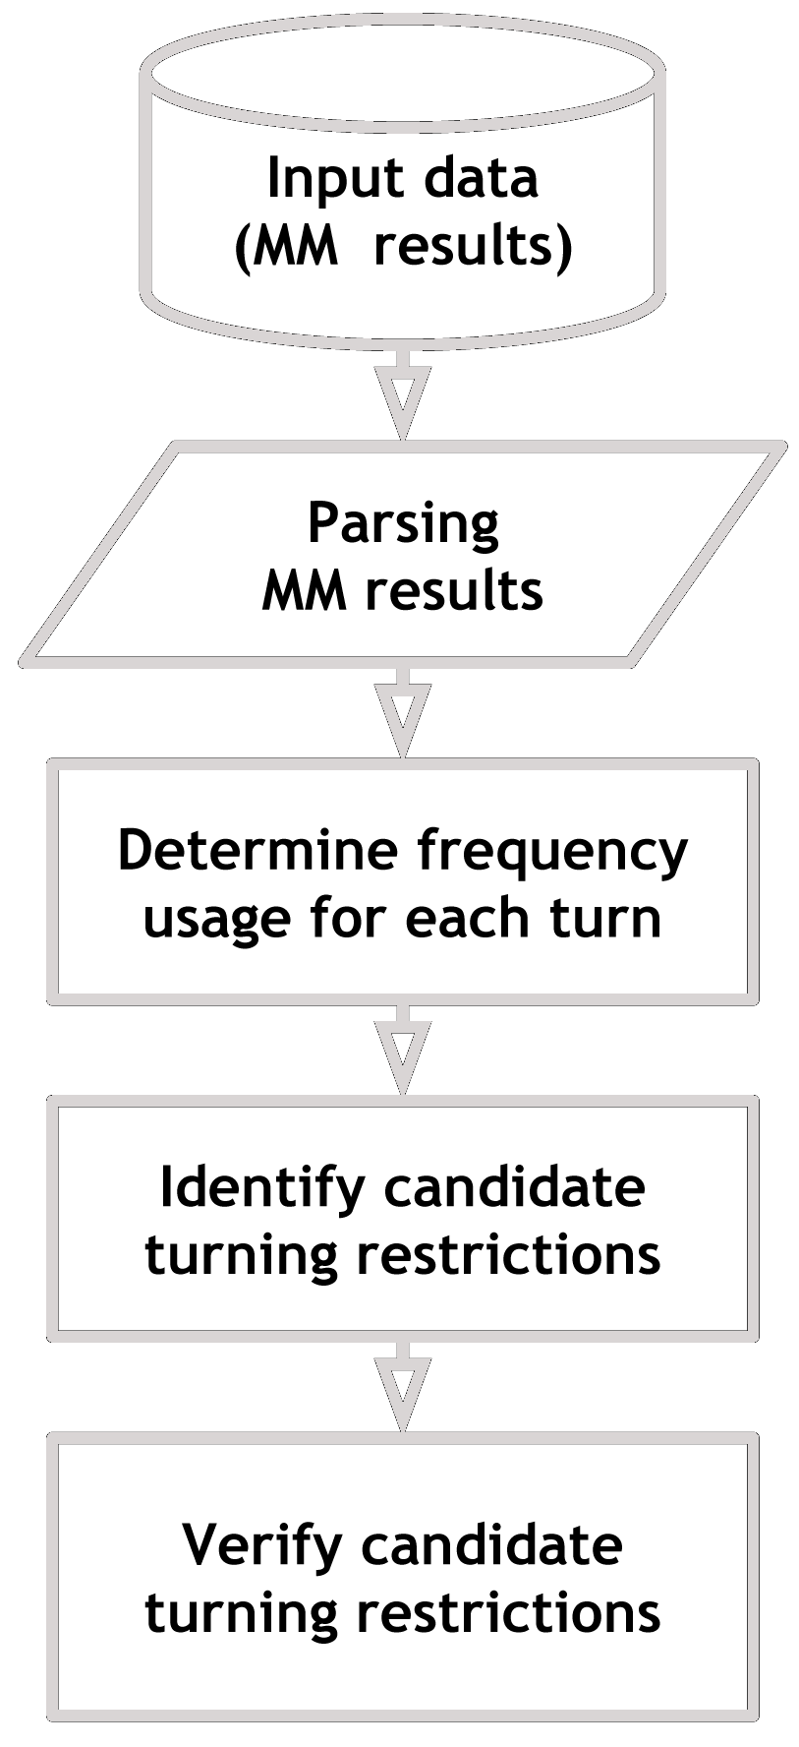
Methodology

Slide 11
Input data
GPS traces of fleet vehicles
Athens, Berlin & Vienna
2,000 – 5,000 vehicles per city
One data point every 60 – 180 sec
GPS trajectories for each vehicle map-matched
Eliminate MM edges of OSM category >10
12-15% of the MM records dropped
One year of data
October 2012 → September 2013
Several GB of compressed historic MM results

Slide 12
Parsing MM results (1/2)
Hundreds of thousands of nodes & edges
Necessary to limit turns to examine
Only pairs of edges that connect at intersection vertices
Vertices order >2
Only intersection vertices connected to roads of OSM category ≤10
Final vertices < 25% of total vertices
 |  |  | # intersection vertices |  | # intersection vertices for roads ≤ 10
city | # vertices | # edges | total | % | total | %
Athens | 277,719 | 329,444 | 100,422 | 36 % | 34,921 | 13 %
Berlin | 89,598 | 103,486 | 51,935 | 58 % | 21,119 | 24 %
Vienna | 100,579 | 112,478 | 44,874 | 45 % | 16,104 | 16 %

Slide 13
Parsing MM results (2/2)
Parse compressed archives of historic MM results
Count instances for each turn
Sufficient number of measurements per intersection vertex
city | # intersection vertices for roads ≤10 | # examined turns | # total instances | # instances per inters. vertex for roads ≤10
Athens | 34,921 | 75,552 | 144,451,729 | 4,137
Berlin | 22,119 | 44,636 | 2,054,969,090 | 97,304
Vienna | 16,104 | 36,484 | 610,902,632 | 37,935

Slide 14
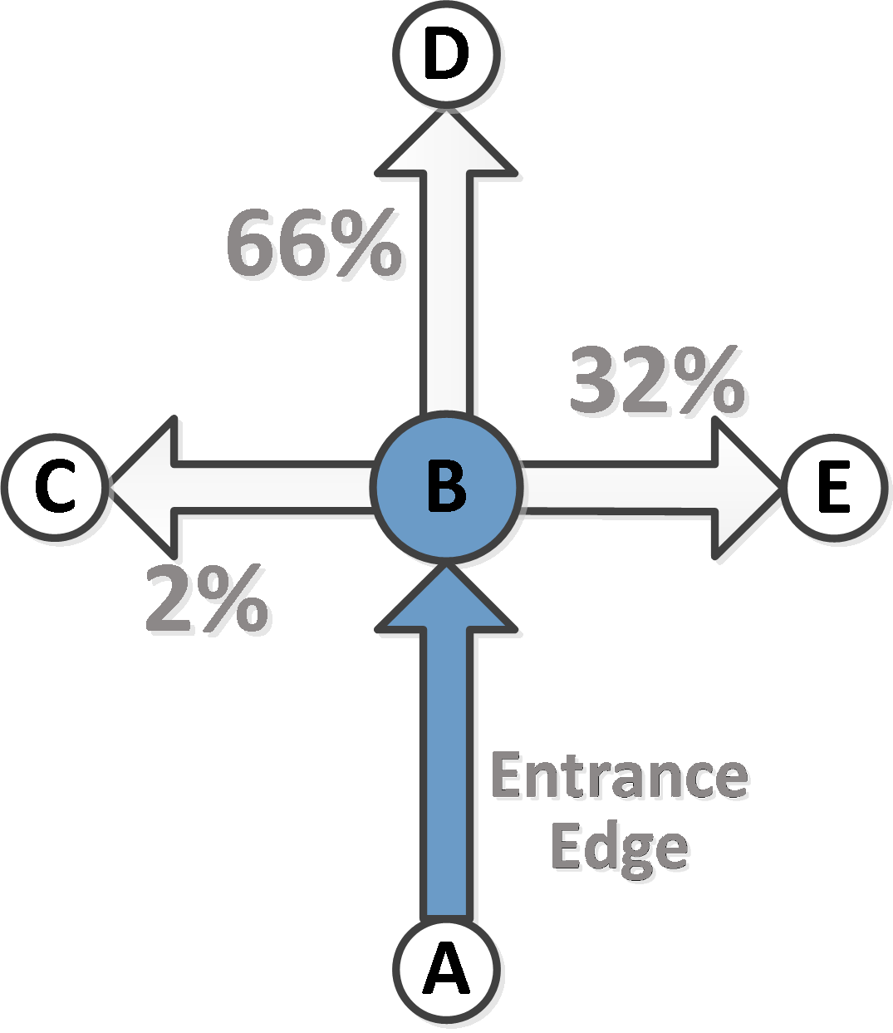
Determine frequency usage of turns
Group turns by
entrance edge and
its direction
Each group:
All turns a vehicle can follow after traversing a specific edge in a specific direction
We know
number of instances of each turn in group
We calculate
percentage of usage for each one

Slide 15
Identify candidate restrictions
Turns with low usage percentage → probably prohibited
Probably erroneous map-matching results
OSM lacks this information
Threshold of 5%
Tweakable
Yet, pretty accurate
 |  | # candidate restrictions |  | candidate restrictions %
city | # turns | 5 % | 2.5 % | 5 % | 2.5 %
Athens | 75,552 | 5,287 | 3,596 | 7.00 % | 4.76 %
Berlin | 44,636 | 2,653 | 1,582 | 5.94 % | 3.54 %
Vienna | 36,484 | 1,739 | 1,261 | 4.77 % | 3.46 %

Slide 16
Direction of restrictions
Conclude if a restriction is about a:
Straight
Left
Right
U-turn
Easy, as we already have the inclination of edges
Most of the candidate restrictions represent left-turns
city | #turning restrictions | straight | left | right | U-turn
Athens | 5,287 | 6.5 % | 45.4 % | 41.6 % | 6.5 %
Berlin | 2,653 | 1.6 % | 64.6 % | 18.6 % | 15.2 %
Vienna | 1,739 | 10.5 % | 44.8 % | 30.0 % | 14.7 %

Slide 17
Verify candidate restrictions
Visualize candidate restrictions
Use an external mapping service
Cross-check if results are similar to ours

Slide 18
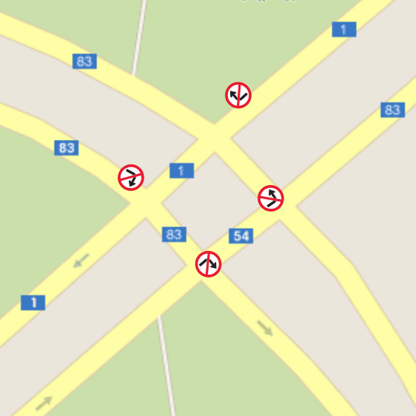
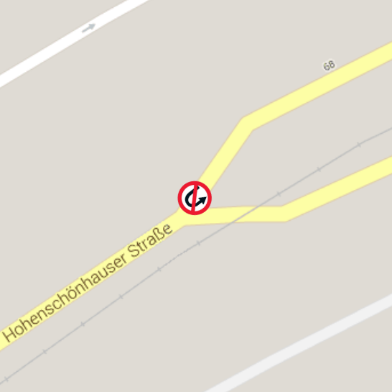
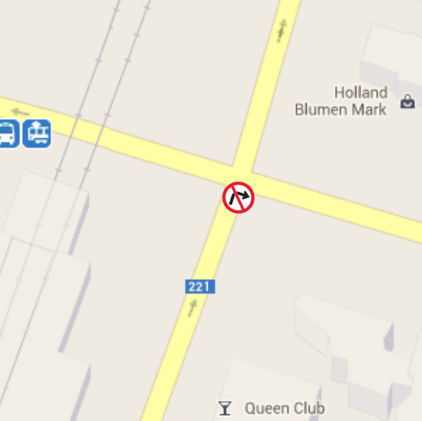
Visual inspection
QGIS
Appropriate traffic sign on intersections of restrictions
Google Map layer in the background
Compare results to an external mapping service
We visually verified many of the candidate restrictions

Slide 19
Sourcing external mapping service
We need to verify & quantify our findings
Through an automatic process
Google Directions API
Not guaranteed to be perfect
Yet, popular & commercial alternative to OSM
Only allows 2,500 requests per 24h from an IP
Important to identify a limited number of candidate restrictions

Slide 20
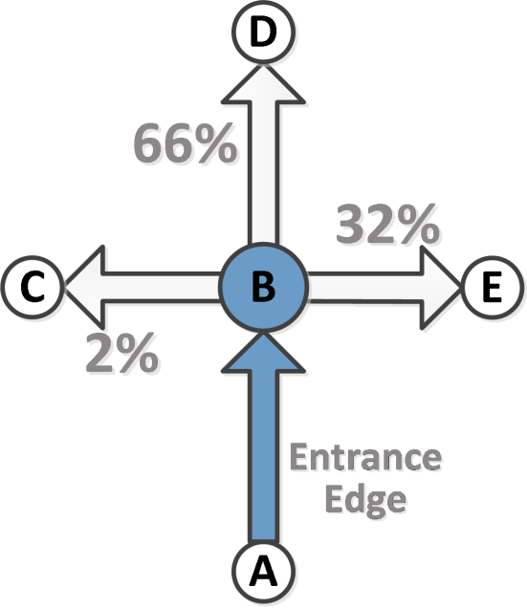
Verification method
http://maps.googleapis.com/maps/api/directions/json?
origin={A_coordinates}
&destination={C_coordinates}
&waypoints=via:{B_coordinates}
&sensor=false
Request returns JSON object
We extract the length of Google’s {A → C via B} path
We have the lengths of edges (A,B), (B,C)
If Google’s path length >> sum of edges’ lengths
Route is much longer than (A,B) → (B,C)
Turning restriction is verified

Slide 21
Verified restrictions
The majority of candidate restrictions were verified
Usually, Google’s paths 85-90% larger than sum of edges’ lengths
Athens & Vienna: 67% verified
Berlin: 57% verified
Respectable amount of restrictions in interval 2.5% - 5%
city | # candidate turning restrictions |  | # verified |  | verified (%)
 | 5 % | 2.5 % | 5 % | 2.5 % | 5 % | 2.5 %
Athens | 5,287 | 3,596 | 3,517 | 2,471 | 67 % | 69 %
Berlin | 2,653 | 1,582 | 1,510 | 1,016 | 57 % | 64 %
Vienna | 1,739 | 1,261 | 1,172 | 880 | 67 % | 70 %

Slide 22
Results overview
Only a few thousand candidate restrictions to verify
Instead of examining hundreds of thousands of turns
By focusing on intersection nodes…
…connecting major roads
Utilizing historic map-matching results
The majority of them verified through Google Directions API
Verified restrictions >> restrictions in OSM datasets
city | total turns | examined turns | candidate restrictions | verified restrictions | OSM restrictions
Athens | 900,397 | 75,552 | 5,287 | 3,517 | 214
Berlin | 252,271 | 44,636 | 2,653 | 1,510 | 668
Vienna | 256,185 | 36,484 | 1,739 | 1,172 | 799

Slide 23
Non-verified restrictions
Google’s path length similar to sum of edges’ lengths
In some cases, less than 80 %
Inconsistencies between the two maps
Even if turns are not really restricted…
They are rarely used
Should still be penalized in shortest-path app
“Unappealing” turns

Slide 24
Conclusion
New way to infer turning restrictions for OSM data
Efficient
Semi-automatic
Utilizing historic map-matching data
57-67% of restrictions extracted were verified
Using an external mapping service
2-16 times more restrictions than the existing in OSM
First to use map-matching results for such a task

Slide 25
Future work
Automatically contribute confirmed restrictions back to OSM project
Improve quality of map-matching algorithms
Map-matching uses partial SP calculations
Until now, turning restrictions not taken into account
New restrictions integrated back in the map-matching algorithm
Self-improving, evolutionary map-matching algorithm!

