Slide 1
Quantifying the Connectivity of a Semantic Warehouse
Y. Tzitzikas^{1,2}, N. Minadakis¹, Y. Marketakis¹, P. Fafalios ^{1,2} ,
C. Alloca¹ and M. Mountantonakis^{1,2}
¹ Institute of Computer Science, FORTH-ICS
² Computer Science Department, University of Crete, GREECE
4th International Workshop on Linked Web Data Management (LWDM),
Athens, May 28, 2014

Slide 2
Outline
Motivation
Context
The process of constructing Semantic Warehouses
The Connectivity Metrics
and results from using them in an operational semantic warehouse
Concluding Remarks
12 minutes

Slide 3
Motivation
In many applications one has to fetch and assemble pieces of information coming from more than one sources (including SPARQL endpoints.)
Def: We use the term Semantic Warehouse (for short warehouse) to refer to a read-only set of RDF triples fetched (and transformed) from different sources that aims at serving a particular set of query requirements.
We focus on the aspects of quality and value (of the query answering) of the warehouse.
Key Questions
How to measure the value and quality (since this is important for e-science) of the warehouse?
How to monitor its quality after each reconstruction or refreshing (as the underlying sources change)?
Notes:
and for this reason we introduce various metrics for quantifying its connectivity,
and consequently its ability to answer complex queries.
We demonstrate the behavior of these metrics in the context
of a real and operational semantic warehouse. The results
are very promising: the proposed metrics-based matrixes allow
someone to get an overview of the contribution (to the
warehouse) of each source and to quantify the benefit of the
entire warehouse. The later is useful also for monitoring the
quality of the warehouse after each reconstruction.

Slide 4
The aspect of Connectivity
In general, connectivity concerns both schema and instances, and it is achieved through common URIs, common literals and equivalence relations (e.g. sameAs)
Why it is useful to measure Connectivity
For assessing how much the aggregated content is connected
For getting an overview of the warehouse
For quantifying the value of the warehouse (query capabilities)
Poor connectivity affects negatively the query capabilities of the warehouse.
For making easier its monitoring after reconstruction
For measuring the contribution of each source to the warehouse, and hence deciding which sources to keep or exclude (there are already hundreds of SPARQL endpoints). Identification of redundant or unconnected sources

Slide 5
Context

Slide 6
Context: iMarine
Id: It is an FP7 Research Infrastructure Project (2011-2014)
Final goal: launch an initiative aimed at establishing and operating an e-infrastructure supporting the principles of the Ecosystem Approach to fisheries management and conservation of marine living resources.
Partners:

Slide 7
Marine Information: in several sources
WoRMS: World Register of Marine Species
Registers more than 200K species
ECOSCOPE- A Knowledge Base About Marine Ecosystems (IRD, France)
FLOD (Fisheries Linked Data) of
Food and Agriculture Organization (FAO) of the United Nations
FishBase: Probably the largest and most extensively
accessed online database
of fish species.
DBpedia

Slide 8
Marine Information: in several sources
Storing complementary information
Taxonomic information
Ecosystem information (e.g. which fish eats which fish)
Commercial codes
General information, occurrence data, including information from other sources
General information, figures

Slide 9
Marine Information: in several sources
Using and accessed through
different technologies
Web services (SOAP/WSDL)
RDF + OWL files
SPARQL Endpoint
Relational Database
SPARQL Endpoint

Slide 10
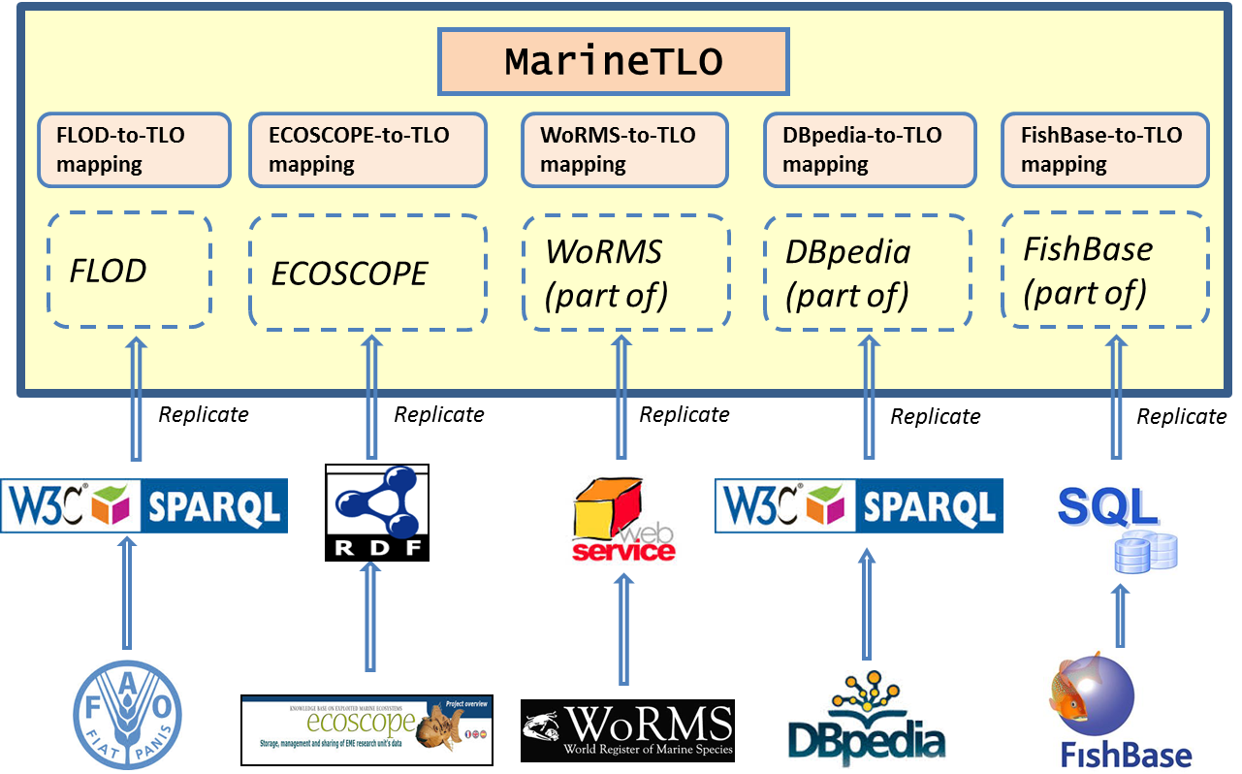
The MarineTLO-based semantic warehouse
Notes:
To integrate these facts we have build and maintain a warehouse
The conceptual backbone is the MarineTLO: a top level ontology.
Provides the foundamental classes and properties.
Appropriate for formulating queries. Appropriate for mappings.

Slide 11
The Warehouse construction and evolution process
Define requirements in terms
of competency queries
produces
uses
Queries
MatWare
Fetch the data from the selected sources
(SPARQL endpoints, services, etc)
produces
Triples
Input for
MatWare
Transform and Ingest to the Warehouse
creates
MatWare
Inspect the connectivity of the Warehouse
uses
Formulate rules creating sameAs relationships
produces
Rules for Instance Matching
Input for
uses
Apply the rules to the warehouse
produces
Input for
sameAs triples
MatWare
Ingest the sameAs relationships
to the warehouse
enriches
Warehouse
Test and evaluate the Warehouse (using the competency queries and the conn. metrics)
uses
MatWare
Notes:
The construction and evolution process consists of the followng

Slide 12
The Metrics

Slide 13
Notations and Preliminaries
S₁ … S_{k}: the underlying sources
triples(S_{i}): the triples that S_{i} contributes to the warehouse W
U_{i}: the URIs in the triples in triples(S_{i})
Lit_{i}: the literals in the triples in triples(S_{i})
How to compare two sets of URIs, e.g. U₁ and U₂?
There are more than one methods
We propose the following three methods (policies)
The metrics that will be introduced can be computed using any of these policies
Notes:
If u1=u2 then certainly equivalent also wrt suffix canonicalization

Slide 14
Example: Suffix-based URI equivalence
=
thunnusalbacares
thunnusalbacares
lower case conversion
ThunnusAlbacares
thunnusalbacares
underscore removal
Thunnus_Albacares
thunnus_albacares
prefix removal
≡
http://www.dbpedia.com/Thunnus_Albacares
http://www.ecoscope.com/thunnus_albacares
last(u): is the string obtained by (a) getting the substring after the last "/" or "\#", and turning the letters of the picked substring to lowercase and deleting the underscore letters that might exist.

Slide 15
Example: Entity Matching-based URI Equivalence
Matching Rule:
If an Ecoscope individual's preflabel in lower case is the same with the attribute label of a FLOD individual then these two individuals are the same.
Thunnus Albacares
thunnus albacares
skos:preflabel
label
http://www.fao.org/figis/flod/entities/codedentity/
636cdcea-c411-43ad-97ff-00c9304f5e60
http://www.ecoscope.com/thunnus_albacares
sameAs
Yannis Tzitzikas et al., LWDM 2014, Athens

Slide 16
Connectivity Metrics
Proposed Metrics
the matrix of percentages of the common URIs
the matrix of percentages of the common literals
the increments in the average degree of each source
the unique triple contribution of each source
the complementarity factor of the entities of interest

Slide 17
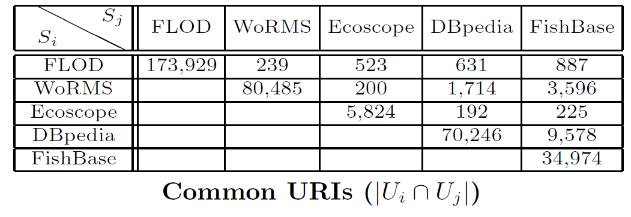
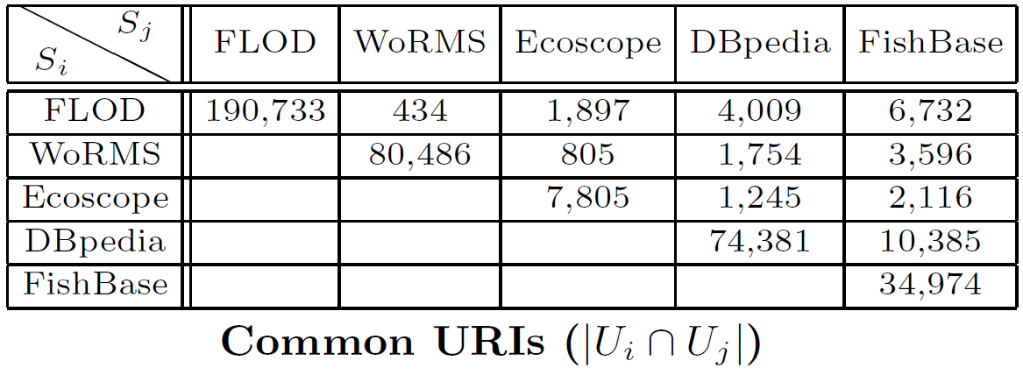
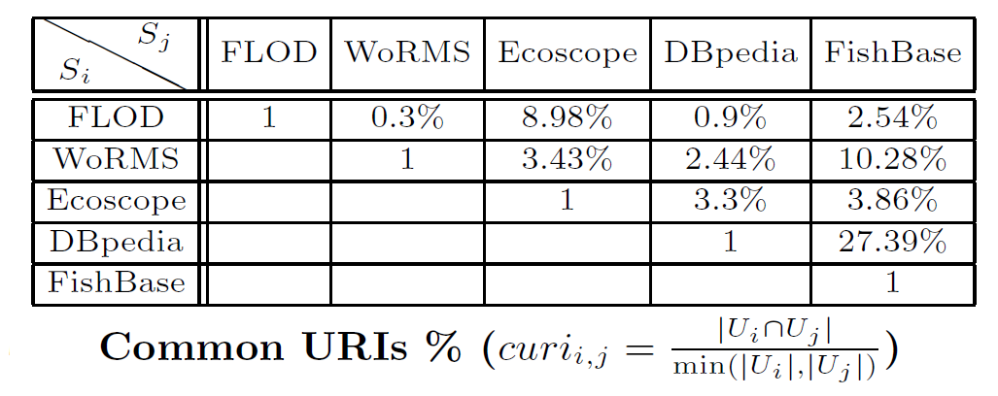
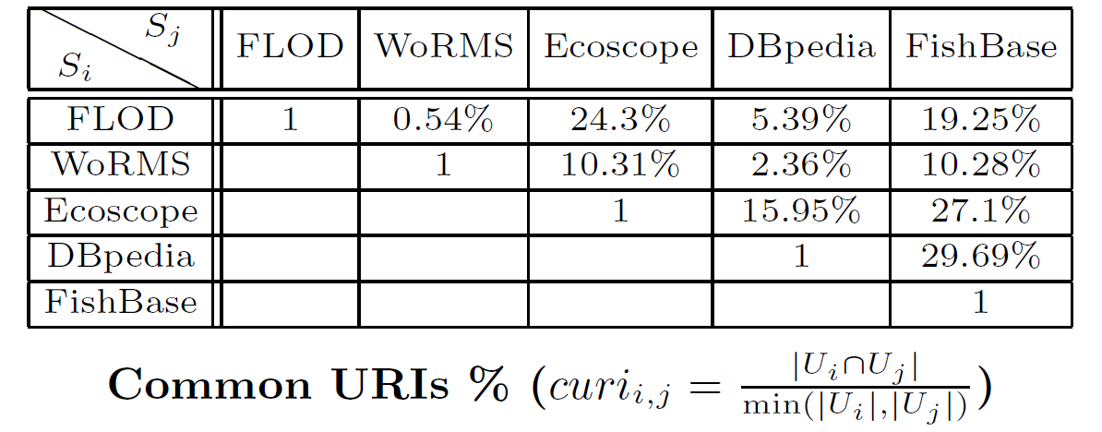
Metric 1 : Matrix of Percentages of Common URIs
The percentage of common URIs between source S_{i} and S_{j}
≡ Suffix canonicalization
≡ Entity Matching
Notes:
In the denominator we use$\min(|U_i|, |U_j|)$instead of $|U_i \cup U_j|$ as in the Jaccard similarity.With Jaccard similarity the integration of a small triple set with a big onewould always give small values, even if the small set contains many URIsthat exist in the big set. For this reason we use {\em min}.

Slide 18
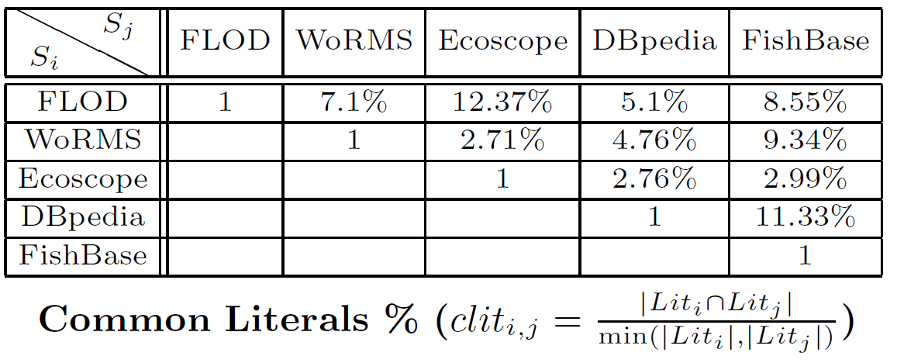
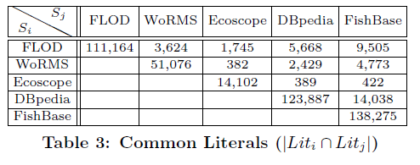
Metric 2 : Matrix of Percentages of Common Literals
The percentage of common Literals between source S_{i} and S_{j}

Slide 19
Metric 3 : Increase in the Average Degree
It shows the increment of the graph-theoretic degree of each entity when it becomes part of the warehouse graph.
where

Slide 20
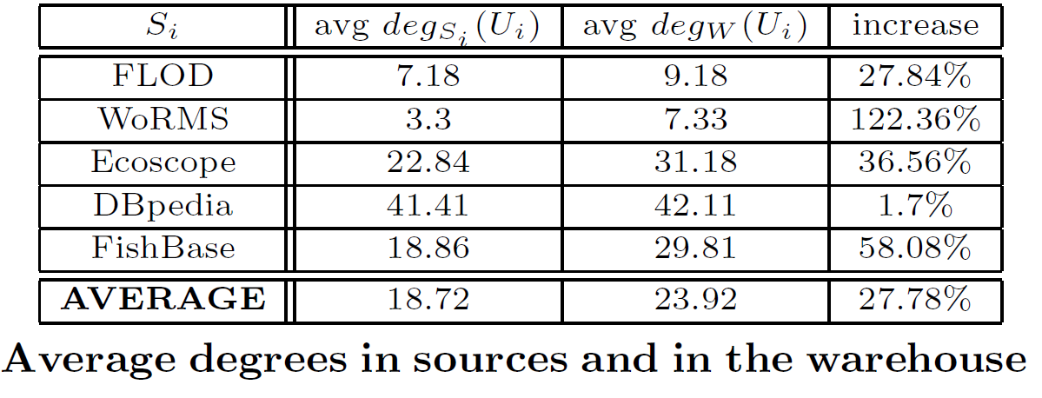
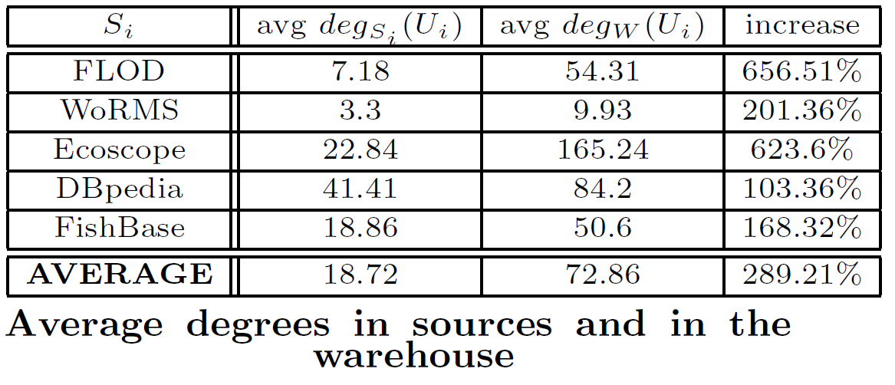
Metric 3 : Increase in the Average Degree
≡ Suffix canonicalization
The average degree is increased from 18.72 to 23.92.
≡ Entity Matching
The average degree, of all sources is signiﬁcantly bigger than before.

Slide 21
Metric 4 : Unique Triple Contribution
It shows the unique triple contribution of each source, which are the number of triples for each source excluding triples that provided by any other source.

Slide 22
Metric 4 : Unique Triple Contribution
≡ Suffix canonicalization
Every source contains a very high percentage of unique triples, so all the sources are important.
≡ Entity Matching (and ingestion transformations)
The execution of the transformation rules results to the creation of new triples for the majority of sources.

Slide 23
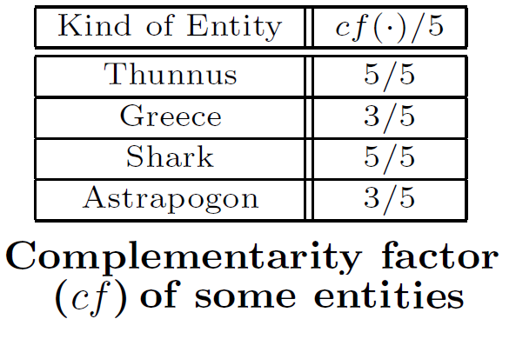
Metric 5 : Complementarity Factor
The complementarity factor of the entities of interest is the number of sources that provided unique triples for each entity of interest
(with the term entity we mean any literal or URI that contains the corresponding entity name, e.g the string “thunnus”)
For the entities Thunnus and Shark, all the sources provided unique triples, but for the entities Greece and Astrapogon only three sources provided unique material.

Slide 24
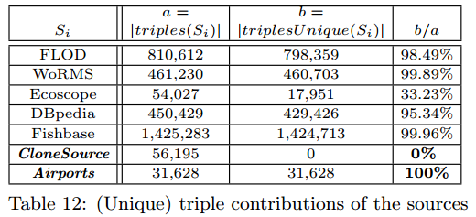
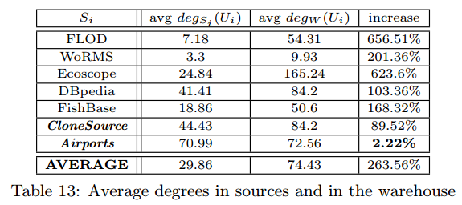
Detecting Redundancies or other Pathological Cases
The metrics allow spotting pathological cases e.g. redundant sources or totally unconnected sources
We defined two artificial sources
CloneSource: a subset of Ecoscope’s and DBpedia’s triples as they are stored in the warehouse.
Airports: containing triples about airports which were fetched from the DBpedia public SPARQL endpoint
Results
CloneSource: 0 unique contribution as expected, since it was composed from triples of existing sources
Airports: The increase in the average degree for the entities of that source was very low (due to some common country names)
General Rules for identifying problematic cases
1) If the unique contribution of a source is very low (resp. zero), then this means that it does not contribute signiﬁcantly (resp. at all) to the warehouse.
2) If the average increase of the degree of the entities of a source is low, then this means that its contents are not connected with the contents of the rest sources.

Slide 25
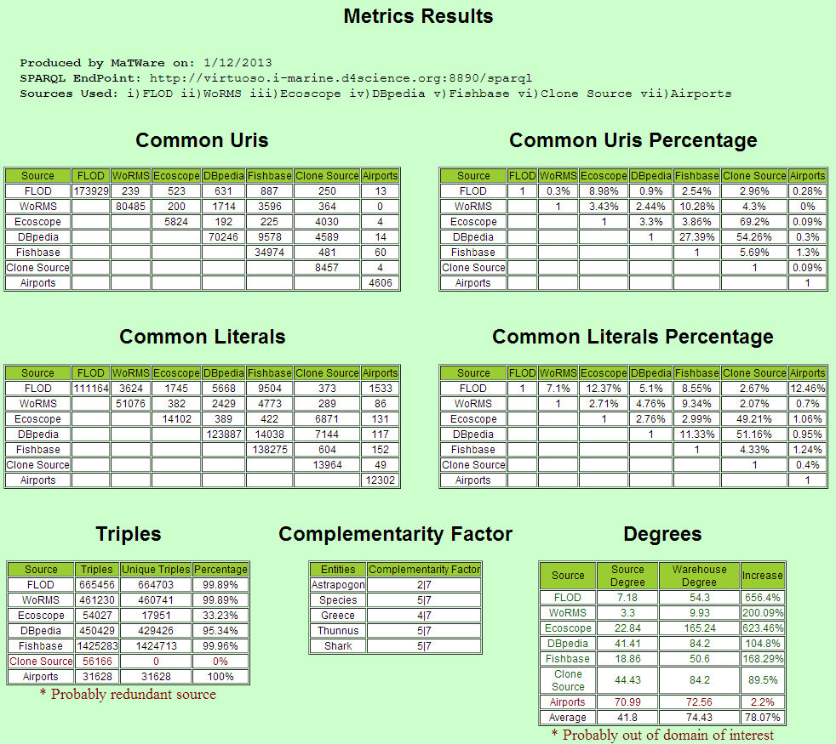
Metrics Results Displayed In HTML as computed by MatWare

Slide 26
Concluding Remarks
We have proposed metrics for quantifying the connectivity of a semantic warehouse:
the matrix of percentages of the common URIs and/or literals,
the complementarity factor of the entities of interest,
the increments in the average degree of each source, and
the unique triple contribution of each source.
By inspecting the proposed metrics-based matrixes one can very quickly get an overview of the contribution of each source and the tangible benefits of the warehouse
The values of (1),(2),(3) allow evaluating the warehouse, while (3) and (4) mainly concern each particular source.
One can exploit these metrics:
Before adding a new source: for investigating if a source is interesting for importing in the warehouse (e.g. to inspect if this source contributes unique information)
After a warehouse update: for inspecting and controlling the evolution of the warehouse, for inspecting if an update of a source affected positively or negatively the connectivity of the warehouse
We are currently working on extension of VoID for expressing and exchanging in machine processable (and query-able) manner these metrics

Slide 27
Thank you for your attention
Visit and send us feedback:
www.ics.forth.gr/isl/MarineTLO
www.ics.forth.gr/isl/MatWare

Slide 28
Links
MatWare
http://www.ics.forth.gr/isl/MatWare/
MarineTLO
http://www.ics.forth.gr/isl/MarineTLO/
TripleStores
MarineTLO-Warehouse: http://virtuoso.i-marine.d4science.org:8890/sparql
also browsable through http://virtuoso.i-marine.d4science.org:8890/fct

Slide 29
EXTRA SLIDES

Slide 30
Testing using Competency Queries
Let q be a query in the set of competency queries. Although we may not know the ``ideal" answer of q, we may know that it should certainly contain a particular set of resources, say Pos, and should not contain a particular set of resources, say Neg. If ans(q) is the answer of q as produced by the warehouse, we would like to hold
Pos ⊆ ans(q) and
Neg ∩ ans(q) =∅.
Since these conditions may not hold, it is beneficial to adopt an IR-inspired evaluation, i.e. compute the precision and recall defined as:
The bigger the values we get the better (ideally 1).The better we know the desired query behavior, the bigger the sets Pos and Neg are, and consequently the more safe the results of such evaluation are.

Slide 31
Metrics illustrated in one slide (todo)

Slide 32
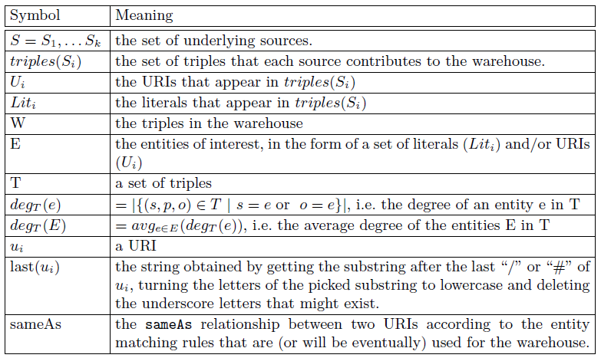
Notations

Slide 33
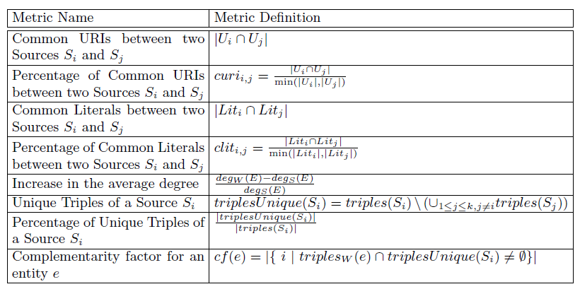
All Metrics in one slide

Slide 34
The MarineTLO-based warehouse’s contents: concepts
Concepts | Ecoscope | FLOD | WoRMS | DBpedia | Fishbase
Species
Scientific Names
Authorships
Common Names
Predators
Ecosystems
Countries
Water Areas
Vessels
Gears
EEZ
iMarine 2nd Review, September 2013,Brussels
Notes:
The new contents of the version 3 of the warehouse according to the main concepts that we are interested in.

Slide 35
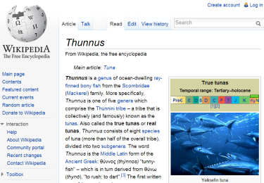
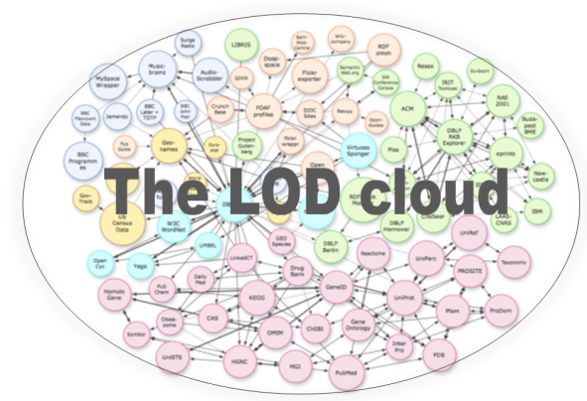
For Semantic Post-Processing: The process
web browsing
contents
query terms
(top-L) results
(+ metadata)
Entity
Mining
MarineTLO
Warehouse
entities / contents
Visualization/Interaction (faceted search, entity exploration, annotation, top-k graphs, etc.)
Semantic Analysis
Grouping,
Ranking
Retrieving more properties
semantic data
Notes:
A few things about the process.
The user submit his query to a search system, e.g. gcubesearch (which can in turn query other sources external or indexes), or any opensearch compliant source.
The service then retrieves … and applies entity mining.
Note that this can be also applied to an individual web page (not necessarily search results).
The entity mining is configured through Linked Data (specifically SPARQL endpoints).
The results of mining are analyzed (grouped, ranked, etc)
and the outcome of this analysis is given to the user
who in turn can interact with them and focus on the desired part of the answer

Slide 36
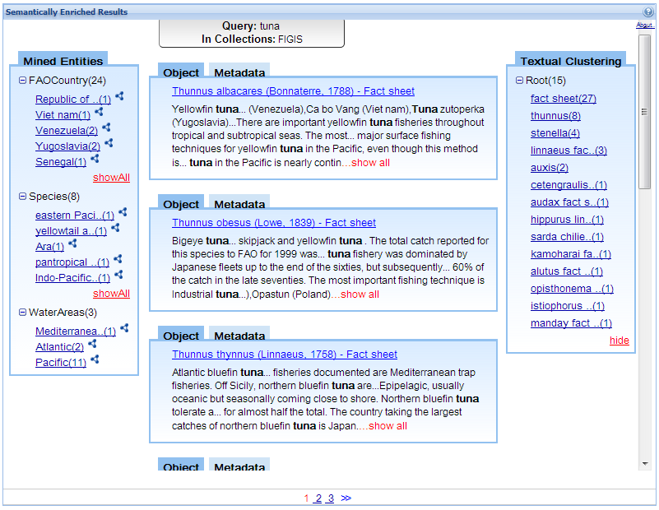
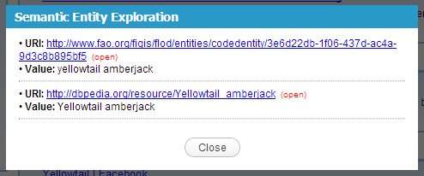
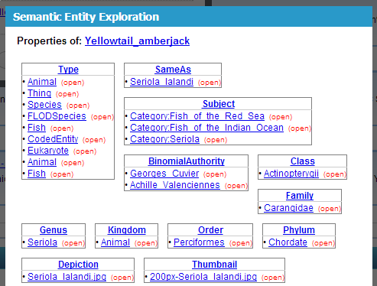
XSearch-Portlet Screenshot
The Warehouse is used
The Warehouse is used
Result of textual clustering
Search Results
Result of Entity Mining
Notes:
Here you can see a screen from the portlet.
At the middle the user is getting the plain search results.
At the left bar …..
By clicking on an entity he can get more information about an entity (the information is fetched at that time).

Slide 37
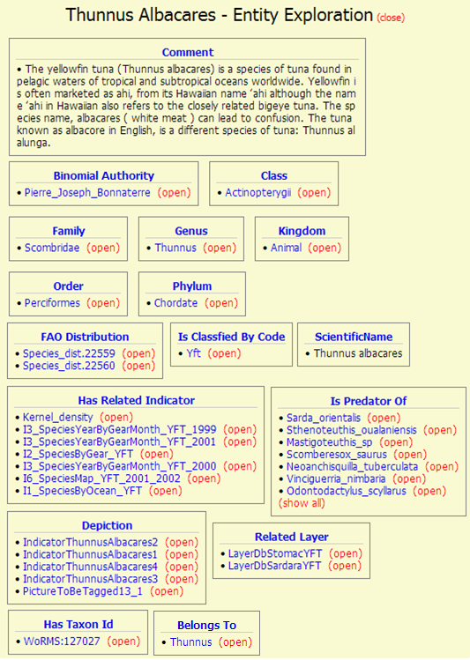
Example of an EntityCard
of Xsearch (if the entity’s type is Species)
The Warehouse is used
From DBpedia
From FLOD
From Ecoscope
From WoRMS
Notes:
Here we can see how Xsearch exploits this warehouse.
Then the user clicks on an entity it gets more complete information
(information that came from 4 sources)

Slide 38
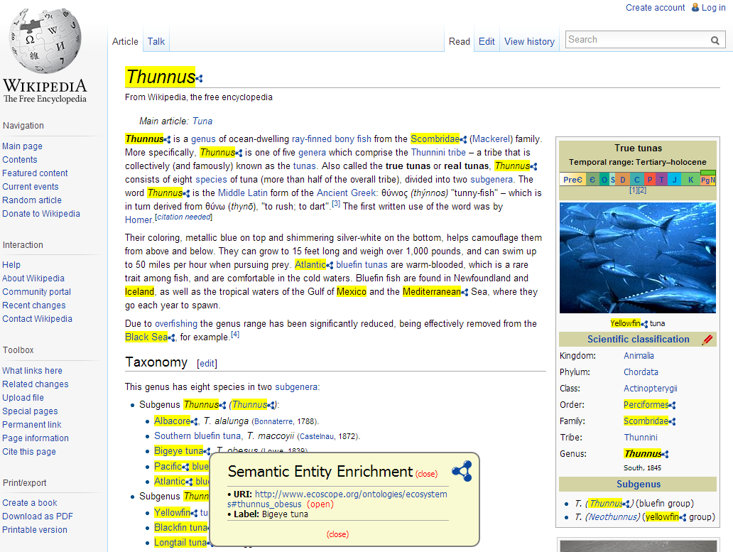
XSearch as a bookmarklet
The Warehouse is used
Annotating entities over the original page
Entity exploration
Notes:
Here we can see how the user can exploit entity mining (and its configurability) when the user browses the web.
Here the automatic annotation is OVER the original page

Slide 39
fasdfasdf

