Slide 1
Similarity Recognition in the Web of Data
Alfio Ferrara
Lorenzo Genta
Stefano Montanelli
4th Int. Workshop on Linked Web Data Management (LWDM 2014)
Athens, Greece - March, 28th 2014

Slide 2
Context and motivations
In the web of data, similarity recognition is the basis for a variety of resource-consuming activities and applications. Such as for example:
data recommendation
data aggregation
data analysis
A lot of research effort has been focused on data matching with a specific attention to instance matching in the framework of the Semantic Web

Slide 3
Why data matching again?
Focus on the scalability issue
Traditional comparison-based approaches work on reducing the O(n²) number of matching operations
Many optimization strategies have been proposed with interesting results
Matching is still an expensive step and offline execution is required for very large datasets to match

Slide 4
Why data matching again?
We are interested in data matching under specific constraints
Resources are defined according to a common schema (extraction from a single repository)
The set of features considered for matching is known in advance (dimensional matching)
Features have a “dense” distribution over the resources to match
Feature values are specified according to a controlled vocabulary

Slide 5
Example of resources to match
muhammad ali (r1) profession - athlete
profession - professional boxer
type - olympic athlete
nationality - United States of America
Resources are represented as sets of feature-value pairs
Set of considered features:
Profession
Nationality
Type
michael jordan (r2)
profession - athlete
type - olympic athlete
type - celebrity
george foreman (r3)
profession - professional boxer
type - olympic athlete
nationality - United States of America
Examples taken from the Freebase repository (http://www.freebase.com)

Slide 6
HMatch4
What is HMatch4:
It is a data matching algorithm
It is natively conceived for working in the web of data
It has been developed on the ground of HMatch3
How HMatch4 works:
The similarity degree of two resources is proportional to the number of common feature-value pairs
An index-based approach is enforced to detect the common feature-value pairs (resource comparison over features is not required)

Slide 7
HM4 at a glance
Given a resource r₁:
Index all the relevant subsets of feature-value pairs belonging to r₁
A resource r₂ is similar to r₁ if it shares the same entry of r₁ in the index, meaning that r₁ and r₂ have a common subset of feature-value pairs
The similarity degree of r₁ and r₂ is assessed by measuring the size (i.e., cardinality) of the shared subset of feature-value pairs

Slide 8
HM4 with an example
muhammad ali (r1) profession - athlete
profession - professional boxer
type - olympic athlete
nationality - United States of America
Index entries
Subset of feature-values pairs | Resource
(profession - athlete), (type – ol. athlete) | r1
(profession – prof. boxer), (type – ol. athlete) | r1
(profession - athlete), (nat. - USA) | r1
(profession – prof. boxer), (nat. – USA) | r1
(type – ol. athlete), (nat. – USA) | r1
(profession - athlete), (type – ol. athlete), (nat. – USA) | r1
(profession - prof. boxer), (type – ol. athlete), (nat. – USA) | r1

Slide 9
HM4 with an example
michael jordan (r2)
profession - athlete
type - olympic athlete
type - celebrity
Index entries
Subset of feature-values pairs | Resource
(profession - athlete), (type – ol. athlete) | r1, r2
(profession - athlete), (type – celebrity) | r2
(profession – prof. boxer), (type – ol. athlete) | r1
(profession - athlete), (nat. - USA) | r1
(profession – prof. boxer), (nat. – USA) | r1
(type – ol. athlete), (nat. – USA) | r1
(profession - athlete), (type – ol. athlete), (nat. – USA) | r1
(profession - prof. boxer), (type – ol. athlete), (nat. – USA) | r1

Slide 10
HM4 with an example
george foreman (r3)
profession - professional boxer
type - olympic athlete
nationality - United States of America
Index entries
Subset of feature-values pairs | Resource
(profession - athlete), (type – ol. athlete) | r1, r2
(profession - athlete), (type – celebrity) | r2
(profession – prof. boxer), (type – ol. athlete) | r1, r3
(profession - athlete), (nat. - USA) | r1
(profession – prof. boxer), (nat. – USA) | r1, r3
(type – ol. athlete), (nat. – USA) | r1, r3
(profession - athlete), (type – ol. athlete), (nat. – USA) | r1
(profession - prof. boxer), (type – ol. athlete), (nat. – USA) | r1, r3

Slide 11
HM4 with an example
What is the similarity of r1, r2, r3?
Take the index entry with the higher number of common feature-value pairs
Use the Dice’s coefficient
sim(r1, r2) = 2*2 / (3+2) = 0.8
sim(r2, r3) = 0
sim(r1, r3) = 2*3 / (3+3) = 1.0
rfs(r_{i},r_{j}) is the relevant feature set of r_{i} and r_{j}
(the index entry of r_{i} and r_{j})
fs(r_{i}) is the feature set of r_{i}

Slide 12
What is a relevant feature set?
Define a matching threshold th (minimum level of similarity for having that two resources are matching resources)
Given two resources r_{i} and r_{j}, how many feature-value pairs do they need to have in common to satisfy th (and thus to be a relevant feature set)?
Sets with less feature-values pairs than X are not considered (in the example th=0.5, |F|=3)
X is the number of needed common feature-value pairs

Slide 13
Issues for the discussion session
Experimental results
Quality?
Scalability?
Application scenarios for HMatch4
Is it possible to relax some constraints?
Support to approximate string matching
Integration with hashing techniques preserving “nearby” positions for similar values

Slide 14
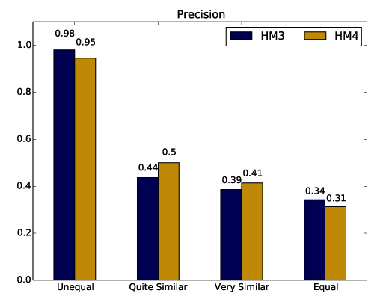
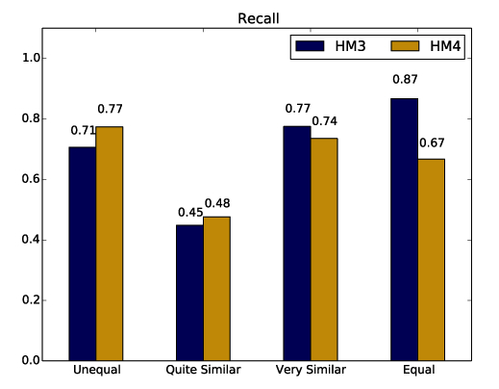
Experimental results - quality
Comparison of Hmatch4 against HMatch3
Dataset of 58 Freebase individuals (1.653 mappings)

Slide 15
Experimental results - scalability
Comparison of Hmatch4 against LogMap and SLINT+
Growing number of individuals (from 58 to 85.144)

Slide 16
Conclusions
Extensive experimentation against very large datasets (millions of instances)
Support to approximate string matching
Integration with hashing techniques preserving “nearby” positions for similar values

Slide 17
Thanks
The ISLab team - http://islab.di.unimi.it/
Alfio Ferrara – alfio.ferrara@unimi.it
Lorenzo Genta – lorenzo.genta@unimi.it
Stefano Montanelli – stefano.montanelli@unimi.it

