Slide 1
Efficient Concept-based Document Ranking
Anastasios Arvanitis
Matthew Wiley
Vagelis Hristidis

Slide 2
Motivation
Electronic Medical Record (EMR) databases:
Variety of semi-structured and unstructured patient information
Terms (concepts) can be linked with rich domain ontologies
UMLS, SNOMED-CT, RxNorm
Relationships among concepts, useful for deriving similarity among medical records or patients
“Patient here for follow up diabetes care. Computer print out of blood sugar shows
average of 201 with 1.7 tests. There is hypoglycemia about 2-3 times a week. Current
Medications: - CELLCEPT 500MG po twice daily - FROSEMIDE 80MG po daily”

Slide 3
Motivation
Interesting query types:
Keyword-based queries: e.g. based on a set of terms find subjects to participate in a clinical study
cohort identification algorithms
glucose, diabetes, Metformin, Glipizide, Glucotrol
Document similarity queries: given a query patient, find similar ones (similar symptoms, vital signs, medication history, etc.)
Concept and document level similarity needs to be quantified

Slide 4
Background
Similarity metrics proposed in biomedical domain
Concept-concept:
structure-based: shortest path distance, path length to the Least Common Ancestor (LCA), etc.
information content-based: measure the amount of information shared, e.g. IC(LCA(c1, c2))
Document-document:
Vector similarity, Jaccard
Melton’s distance: avg. of the min distance from each concept of one document to a concept of the other document and vice versa - symmetrical
The most effective measure depends on collection or ontology properties

Slide 5
Definitions (Distances)
concept-concept: D(c_{i}, c_{j}): shortest path
concept-document:
document-query q={q₁,…q_{n}}:
document-document: Melton’s distance

Slide 6
Definitions (Queries)
Relevant Document Search (RDS):
Given a set of query concepts q={q₁,…q_{n}}, a document corpus D and an integer k>0, find the set D’⊂D, such that |D’|= k and ∀d’∈D’, d ∈ D−D’, D_{dq}(d‘,q) ≤ D_{dq}(d,q)
document-query distance (unidirectional)
Similar Document Search (SDS):
Given a query document d_{q}, a document corpus D and an integer k>0, find the set D’ ⊂ D, such that |D’|= k and ∀d’ ∈ D’, d ∈ D − D’, D_{dd}(d‘,d_{q}) ≤ D_{dd}(d,d_{q})
document-document distance (bidirectional)

Slide 7
Challenges
Efficiency and scalability
A typical EMR database can have hundreds of millions of EMRs
UMLS ontology consists of 2.9M concepts
distance calculations can be computationally expensive
Indexing all pairwise concept-concept distances is not practical (O(n²) space complexity)
Document-document similarity is bidirectional
Building a postings list per concept and applying a top-k algorithm
Threshold Algorithm would access too many postings lists

Slide 8
Contributions of this paper
D-Radix: a subgraph representation of a document based on its concepts
DRC: an efficient real-time document-document distance calculation algorithm, based on the D-Radix index
kNDS: a branch-and-bound algorithm to retrieve the k most relevant/similar documents

Slide 9
System Overview
EMR database
NLP Processing
Inverted Index
DRC (distances calculation)
MIMIC II
1. Abbreviation Expansion
2. Entity Extraction and Annotation
3. Negation Identification
Annotated Corpus
Top-k Results
kNDS
(top-k retrieval)
Abbreviations
Dictionary
MetaMap
RDS
SDS
User Queries
SNOMED & UMLS Ontologies

Slide 10
Outline
D-Radix and Distance Calculation
k-Nearest Document Search

Slide 11
Outline
D-Radix and Distance Calculation
k-Nearest Document Search

Slide 12
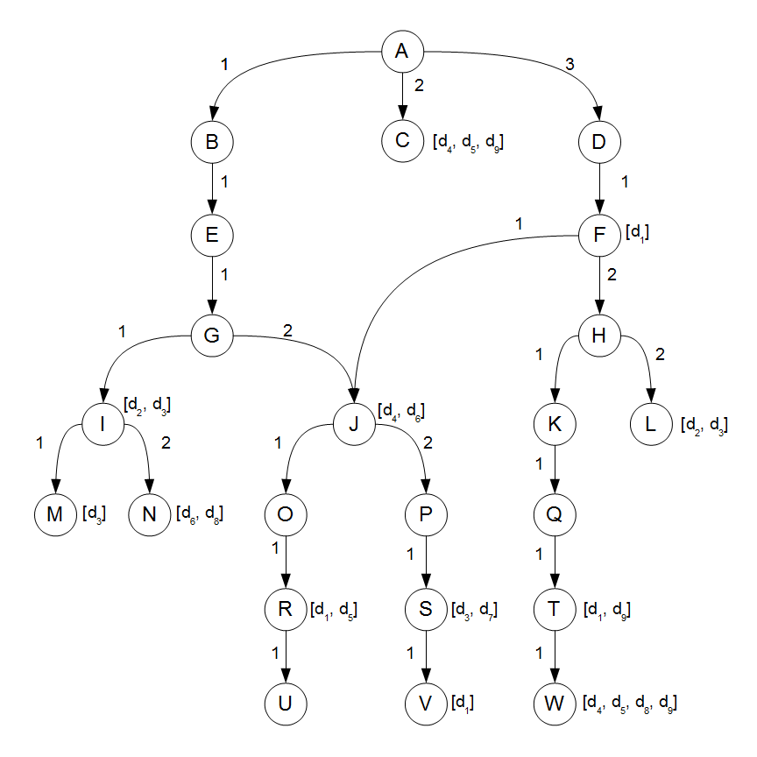
Tries and Radix DAGs
- Labeled DAG
representing an ontology
- Edge labels follow the
Dewey prefix encoding

Slide 13
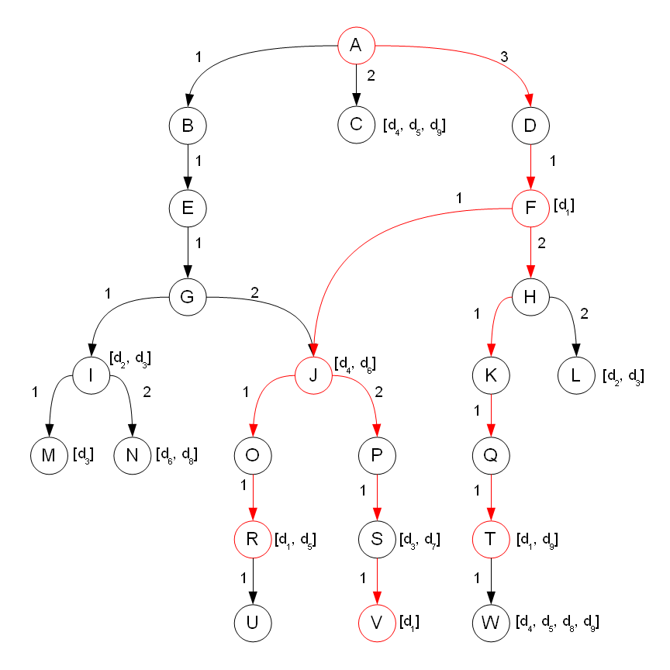
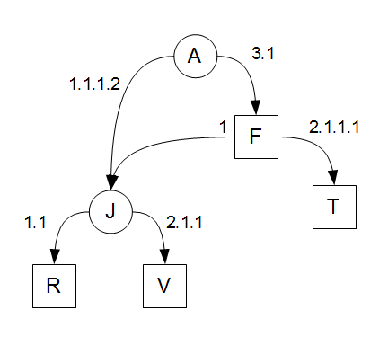
Tries and Radix DAGs
Compact representation of document d₁ = {F,R,T,V}
- Red edges kept in Radix
- Squares: nodes of d₁

Slide 14
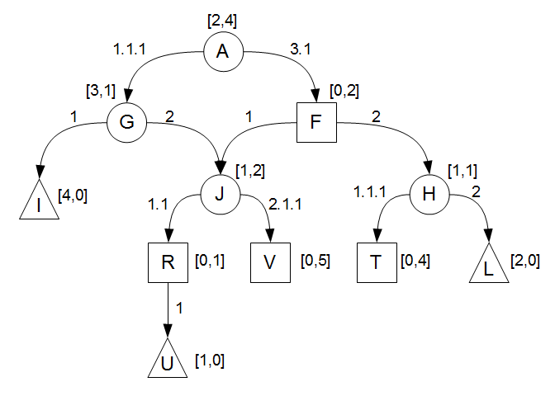
D-Radix Index
Radix DAG that indexes all concept nodes found in either q or d
each node maintains the distances to the nearest node of q and d
D-Radix for d₁ = {F, R, T, V} and q = {I, L, U}
- Squares: nodes of d, triangles: nodes of q
- Numbers: minimum distances from d and q respectively

Slide 15
Calculating Distances
For RDS query:
build D-Radix for d₁,q
use attached distances to calculate D_{dq}(d₁,q)
Similar for SDS
D_{dq}(d₁,q)=D_{dc}(d₁,I)+D_{dc}(d₁,L)+D_{dc}(d₁,U)=4+2+1=7
D-Radix for d₁ = {F, R, T, V} and q = {I, L, U}
- Squares: nodes of d, triangles: nodes of q
- Numbers: minimum distances from d and q respectively

Slide 16
D-Radix Construction Algorithm (DRC)
Construction:
iteratively add a path to a node of the query or document (recall that the ontology is a DAG)
each path insertion might create a new node or split/merge existing paths – avoid duplicate paths
set distances to ∞ except when the inserted node is contained in the query or document
Tuning:
Bottom up and top-down traversal
Propagate shortest distances by setting the distance equal to the minimum of:
the previous distance
the distance from its children or parent nodes + the edge length

Slide 17
DRC Complexity Analysis
P_{q} and P_{d}: sets of path addresses to nodes of q and d respectively
|P_{q}|+|P_{d}| construction steps
D-Radix height is log(|P_{q}|+|P_{d}|)
O((|P_{q}|+|P_{d}|)log(|P_{q}|+|P_{d}|)) for construction
O(|P_{q}|+|P_{d}|) for tuning
O((|P_{q}|+|P_{d}|)log(|P_{q}|+|P_{d}|)) in total
improves over O(n²) of baseline (n: number of concepts)

Slide 18
Outline
D-Radix and Distance Calculation
k-Nearest Document Search

Slide 19
k-Nearest Document Search (kNDS)
Baseline: precompute all document-concept distances → build postings lists → execute a threshold algorithm
In SDS distance is symmetric:
threshold algorithm expands to concepts found in examined document
needs to access many postings – not efficient
We propose a query expansion approach:
start from the query nodes
perform parallel breadth-first traversals of the ontology graph
terminate when we have found at least k documents with lower distance than any non-examined document, report results

Slide 20
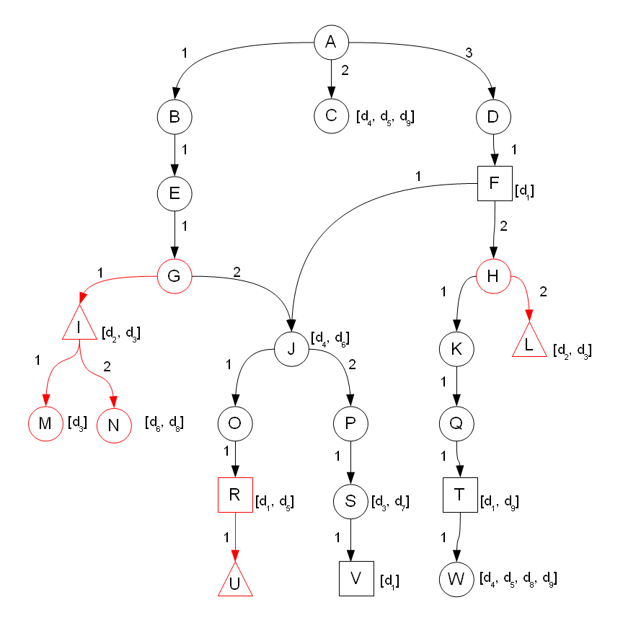
kNDS Example
Query q = {I,L,U}
Document d₁ = {F,R,T,V}
1st iteration visits {G,H,M,N,R}
D_{dc}{d₁,U} = 1
D⁻_{dc}{d₁,I} = 2
D⁻_{dc}{d₁,L} = 2
D⁻_{dq}(d₁,q) = 1 + 2 + 2 = 5

Slide 21
Partial and lower bound distances
Let M_{d}(q,d) be a hash that maps a query node q_{i} to the distance of the nearest document node
In the example: M_{d}(q, d₁) = {U,1}
In BFS iteration l, kNDS maintains the following distances (for RDS):

Slide 22
Branch and Bound execution
start from query nodes and perform parallel BFS
for any document associated with visited nodes calculate partial and lower bound distances
maintain a min-heap of k documents with final distances (all their concepts found)
prune documents with lower bound greater than the distance of the k-th document in the heap

Slide 23
Algorithmic Challenges
Documents contain hundreds or thousands of concepts → very unlikely to cover all concepts → restricted pruning ability
Tradeoff:
BFS traversal until covering all concepts explodes the memory (nodes are kept in priority queue)
DRC calls to calculate the exact distances can be unnecessary and expensive
Workaround:
instead of covering all concepts, use DRC to calculate distances
call DRC *only* when sufficient concepts have been found and document is “expected” to belong to top-k

Slide 24
Error-based estimation
compare ε_{d} with ε_{θ} (error threshold)
if ε_{d} < ε_{θ} then call DRC
otherwise, continue BFS
setting of ε_{θ} depends on corpus and ontology properties (see experimental evaluation)
book-keeping details and optimizations in the paper

Slide 25
Experimental Setting
MIMIC II EMR database:
42,144 anonymized clinical notes over 983 patients:
MD Notes
Nurse Notes
Radiology Reports
Discharge Summaries
Constructed 2 datasets:
RADIOlogy
PATIENT (combines all clinical notes related to a patient)
Experiments:
Distance calculation
Document ranking

Slide 26
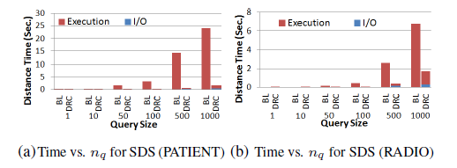
Distance Calculation Time vs Query Size
BL: Baseline O(n²) distance calculation
5000 randomly generated query documents with n_{q} concepts each.

Slide 27
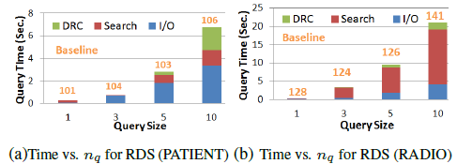
Query Time vs Query Size
Baseline (no pruning) uses DRC for distance calculation
100 randomly generated queries
Lower n_{q} causes fewer DRC calls
DRC is more expensive for PATIENT dataset (more concepts/document)

Slide 28
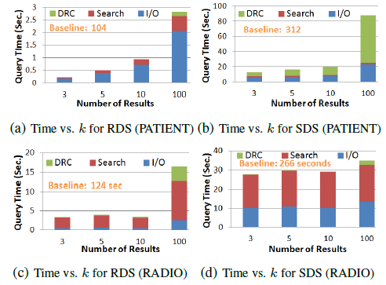
Query Time vs Number of Results
Notes:
Performance of kNDS is not affected significantly by the number of results k
PATIENT dataset contains more concepts per document (patient record) -> DRC is more expensive
kNDS is about 90% faster than Baseline

Slide 29
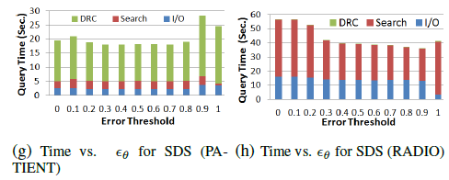
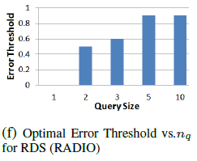
Query Time vs Error Threshold
- Optimal ε_{θ} is higher for
queries with larger size →
1 or 2 concepts are often enough
- DRC calls are targeted to top-k
results in 99% for RDS and 60% of SDS
under optimal settings of ε_{θ}

Slide 30
Conclusions
compact representation of concept-rich documents using an extension of the Radix tree
algorithm that reduces the complexity of distance calculation from O(n²) to O(nlogn)
branch-and-bound algorithm to retrieve the k most relevant/similar documents
Notes:
Future work:
We plan to combine our methods with IR ranking and explore other semantic distances.
We also aim to study how non is-a ontological
edges can be incorporated into the similarity function and how this
would affect the algorithms’ performance.

Slide 31
Questions?
Thanks

