Slide 1
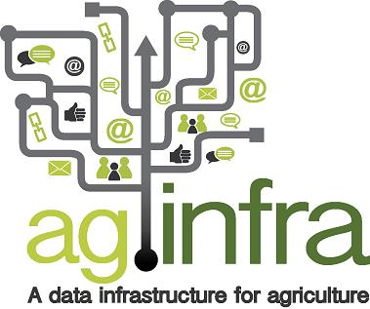
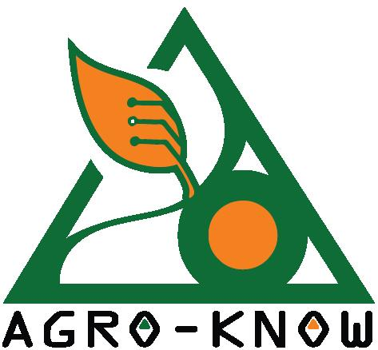
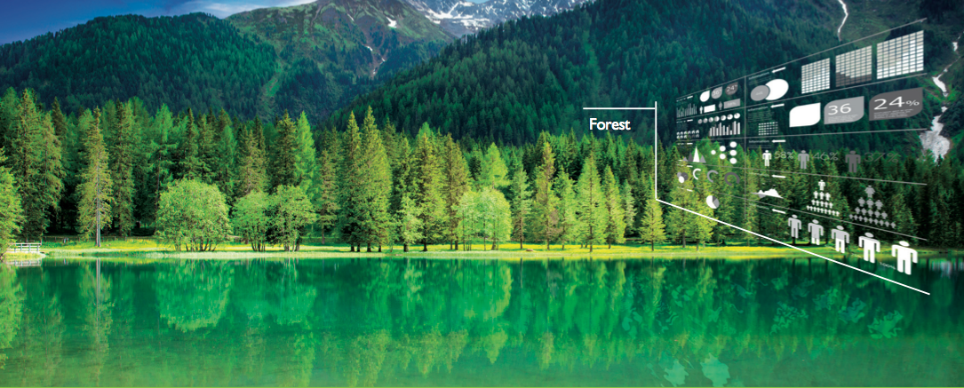
Big data in agriculture
Andreas Drakos
Project Manager, Agro-Know

Slide 2
Presentation Outline
The importance of Big Data in Agriculture
Major challenges
The agINFRA and SemaGrow solutions
Supporting Global Initiatives

Slide 3
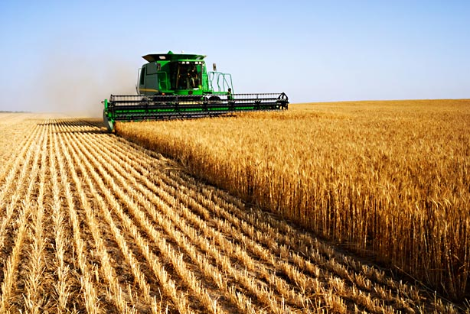
Intro to OPEN DATA in agriculture

Slide 4
Agriculture data to solve major societal challenges
All demographic and food demand projections suggest that, by 2050, the planet will face severe food crises due to our inability to meet agricultural demand – by 2050:
  9.3 billion global population, 34% higher than today
  70% of the world’s population will be urban, compared to 49% today
  food production (net of food used for biofuels) must increase by 70%
According to these projections, and in order to achieve the forecasted food levels by 2050, a total investment of USD 83 billion per annum will be required

Slide 5
Open Data in Agriculture
In an era of Big Data, one of the most promising routes to bootstrap innovation in agriculture is by the use of Open Data:
  e.g. provisioning, maintaining, enriching with relevant metadata, making openly available a vast amount of information
The use and wide dissemination of these data sets is strongly advocated by a number of global and national policy makers such as:
  The New Alliance for Food Security and Nutrition G-8 initiative
  Food & Agriculture Organization of the UN
  DEFRA & DFID in UK
  USDA & USAID in the US

Slide 6
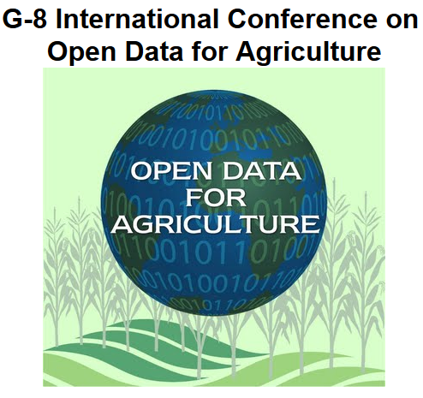
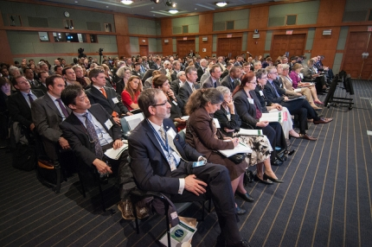
Open Data in agriculture: a political priority
“How Open Data can be harnessed to help meet the challenge of sustainably feeding nine billion people by 2050”
April, 2013, Washington, D.C. USA
Notes:
G-8 International Conference on Open Data for Agriculture: https://sites.google.com/site/g8opendataconference/home

Slide 7
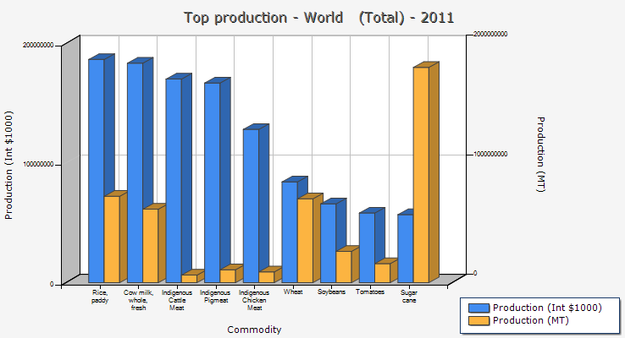
A huge market, globally
Food & Agricultural commodities production, http://faostat.fao.org

Slide 8
Some figures
Food - Gross Production Value globally in 2011: $2,318,966,621
Agriculture - Gross Production Value globally in 2011: $2,405,001,443
Investment in agriculture - Gross Capital Stock globally: $5,356,830,000
… they are big

Slide 9
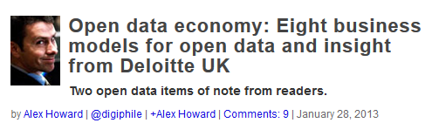
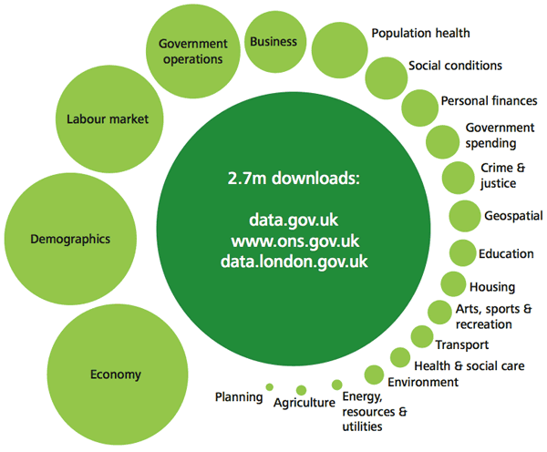
Open data for businesses

Slide 10
Farmers starting to capitalize on
Big Data technology
Freeing farmers from the constraints of uncertain factors
  Dairy farm in UK with ‘connected’ herd
    anticipating the risks of epidemics and spotting random factors in milk production
  Monsanto’s new acquisition protects farmers from weather issues
The spread of smart sensors
  Wine-growers in Spain reduced application of fertilizers and fungicides by 20%, accompanied by a 15% improvement in overall productivity using humidity sensors
Notes:
http://www.atelier.net/en/trends/articles/farmers-starting-capitalize-big-data-technology_424444

Slide 11
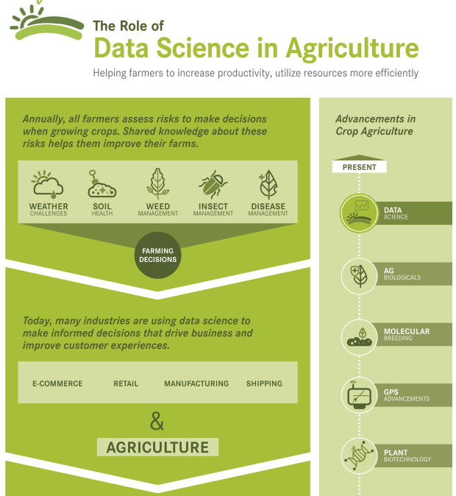
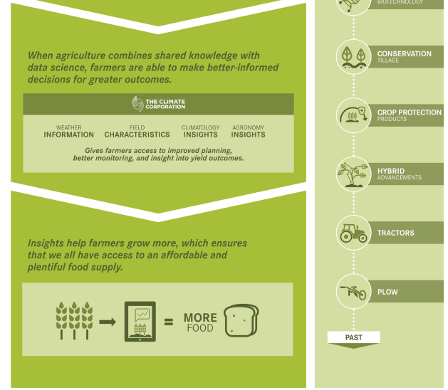

Slide 12
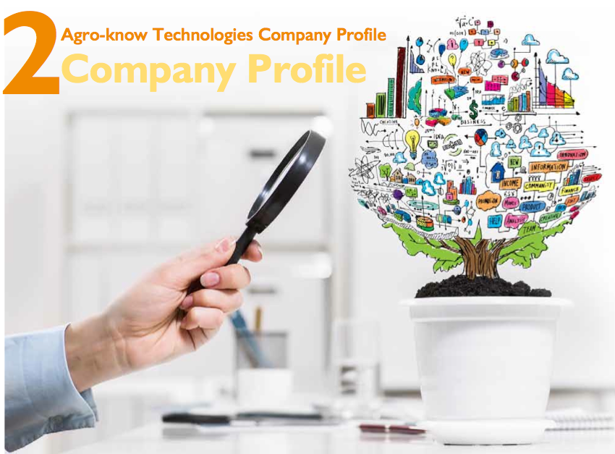
BIG data in Agriculture

Slide 13
Agricultural data types I
Publications, theses, reports, other grey literature
Educational material and content, courseware
Research data,
  Primary data, such as measurements & observations
  structured, e.g. datasets as tables
  digitized, e.g. images, videos
  Secondary data, such as processed elaborations
  e.g. dendrograms, pie charts, models
Sensor data

Slide 14
Agricultural data types II
Provenance information, incl. authors, their organizations and projects
Experimental protocols & methods
Social data, tags, ratings, etc.
Germplasm data
Soil maps
Statistical data
Financial data

Slide 15
Big Data demand…
Storage
  High volume storage
  Impractical or impossible to use centralized storage
    Distribution
    Federation
Computational power
  For efficient discovering / querying
  For aggregating and processing
  For joining
Notes:
Mention Velocity, Variety, Volume, Value, Viscocity, Virality

Slide 16
Rationale: Problem statement
Enable the inclusion of:
  Large, live, constantly updated datasets and streams
  Heterogeneous data
Involve publishers that
  cannot or will not directly and immediately make the transition to standards and best practices
Open Agricultural Data Liaison Meeting
30-31/10/2013

Slide 17
Use Cases (DLO)
Heterogeneous Data Collections & Streams
Big data:
  Sensor data: soil data, weather
  GIS data: land usage, forest and natural resources management data
  Historical data: crop yield, economic data
  Forecasts: climate change models
Problem:
  Combine heterogeneous sources to analyze past food production and forecast future trends
  Cannot clone and translate: large scale, live data streams
  Cannot immediately and directly affect radical re-design of all sensing and processing currently in place
3rd Plenary & ESG Meeting
21/10/2013

Slide 18
Use Cases (FAO)
Reactive Data Analysis
Big data:
  Document collections: past experiences, analysis and research results
  Databases: climate conditions and crop yield observations, economic data (land and food prices)
Problem:
  Retrieving complete and accurate information to compile reports
    Raw data and reports, scientific publications, etc.
  Wastes human resources that could analyze data and synthesize useful knowledge and advice for food production
    Too much time spent cross-relating responses from different sources
  Too many different organizations and processes rely on the different schemas to make re-design viable
  Cloning is inefficient: large and constantly updated stores
3rd Plenary & ESG Meeting
21/10/2013

Slide 19
Use Cases (AK)
Reactive Resource Discovery
Big data:
  Multimedia content about agriculture and biodiversity
Problem:
  Real-time retrieval of relevant content
  Used to compile educational activities
  Schema heterogeneity:
    Different providers (Oganic edunet, Europeana, VOA3R, etc.)
  Too many different organizations and processes rely on the different schema to make re-design viable
  Cloning is inefficient: large and constantly updated stores
3rd Plenary & ESG Meeting
21/10/2013

Slide 20

The aginfra & semagrow solutions

Slide 21
The agINFRA project
e-infrastructure for agricultural research resources (content/data) and services
Higher interoperability between agricultural and other data resources (linked data)
Improved research data services and tools using Grid and Cloud resources

Slide 22
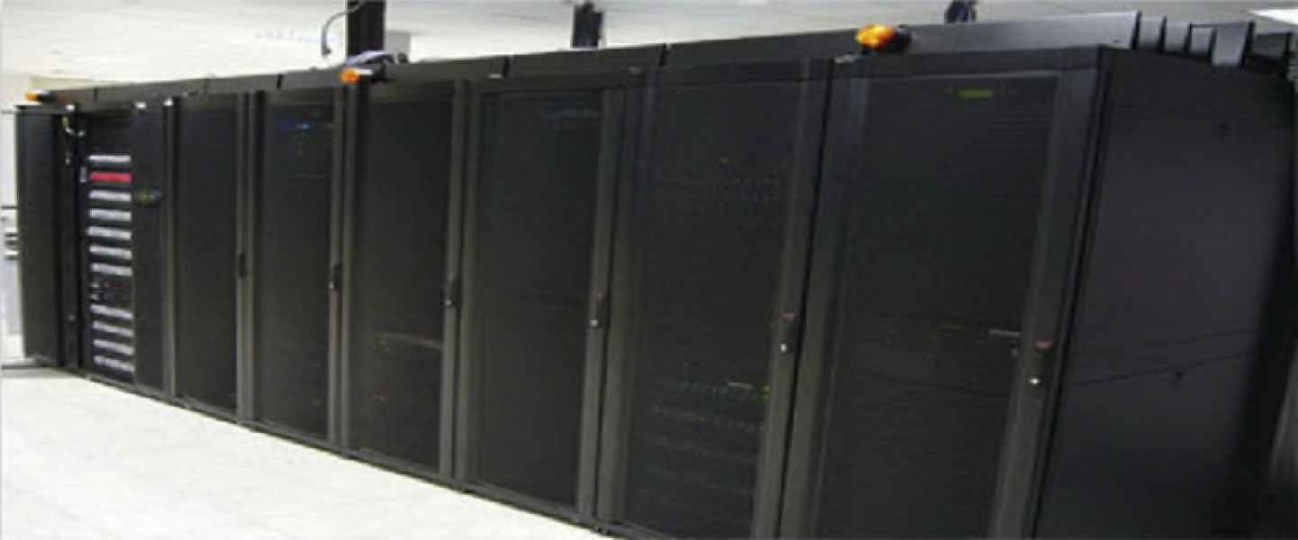
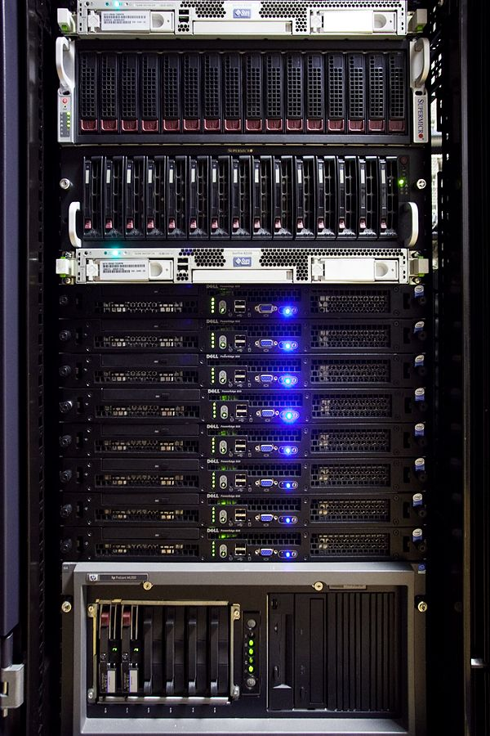
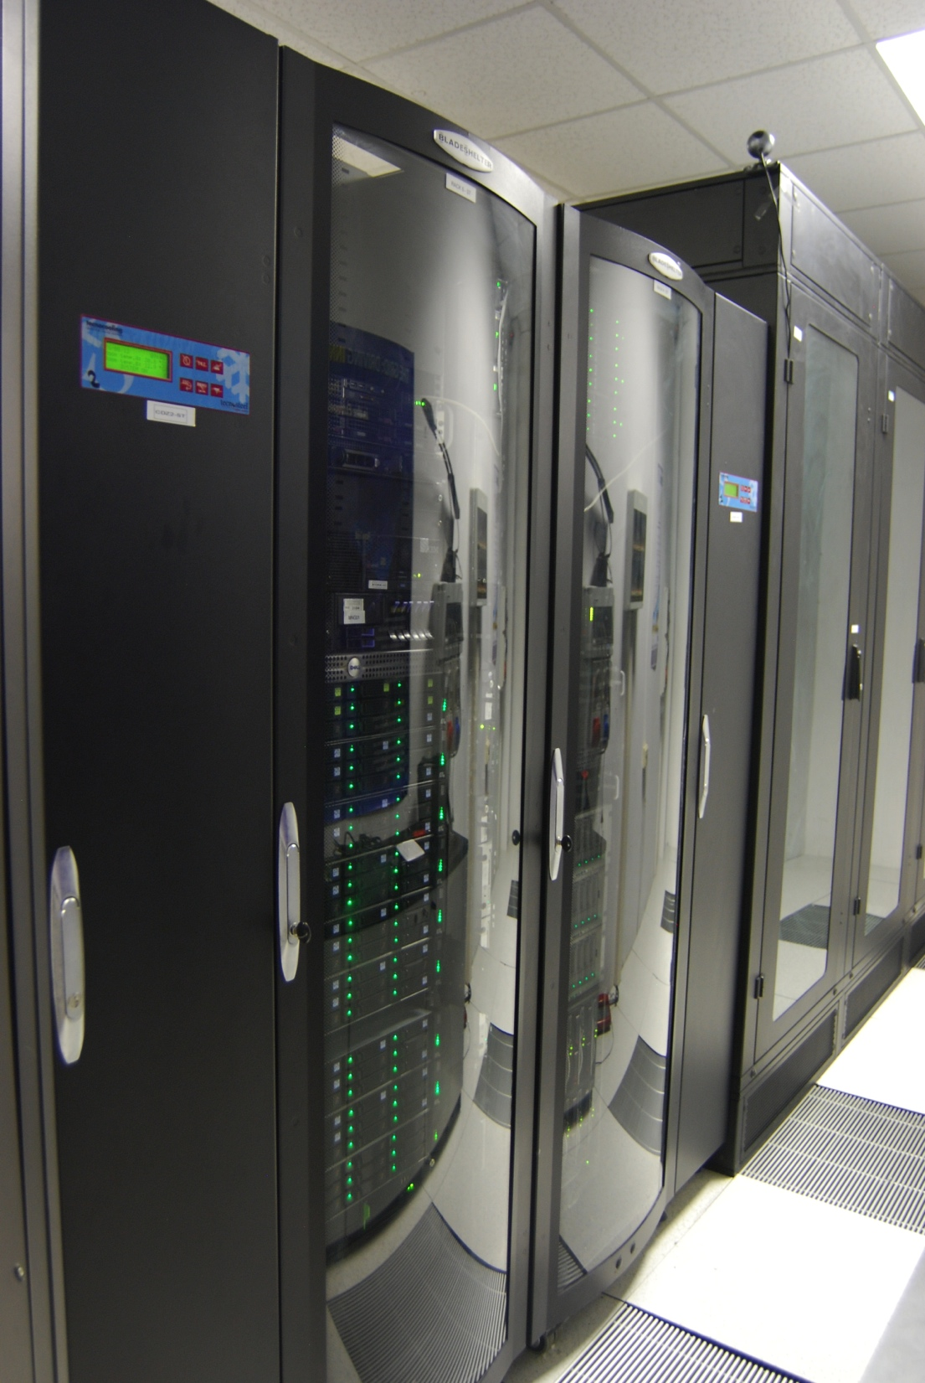
agINFRA Grid & Cloud resources
PARADOX cluster
704 CPU; 50 TB
Roma Tre cluster
350 CPUs; 100TB
Catania cluster
800 CPUs; 700 TB
SZTAKI cluster
8 CPUs
PARADOX upgrade
1696 CPU;100 TB
Total: 3.5 kCPU; 0.9 PT

Slide 23
The SemaGrow project
Develop novel algorithms and methods for querying distributed triple stores
Overcome problems stemming from heterogeneity and unbalanced distribution of data
Develop scalable and robust semantic indexing algorithms that can serve detailed and accurate data summaries and other data source annotations about extremely large datasets
Notes:
Overcome problems stemming from heterogeneity and from the fact that the distribution of data over nodes is not determined by the needs of better load balancing and more efficient resource discovery, but by data providers

Slide 24
The SemaGrow Stack
Integrates the components in order to offer a single SPARQL endpoint that federates a number of heterogeneous data sources
Targets the federation of independently provided data sources
Use POWDER to mass-annotate large-subspaces
  W3C recommendation, exploits natural groupings of URIs to annotate all resources in a subset of the URI space

Slide 25
Moving Forward

Slide 26
What Semantic Web can bring into the picture
One Data Access Point for the entire Data Cloud
  Enabling Service-Data level agreements with Data providers
Application-level Vocabularies / Thesauri / Ontologies
  Enabling different application facets for different communities of users over the SAME data pool
Going beyond existing Distributed Triple Store Implementations
  Link Heterogeneous but Semantically Connected Data
  Index Extremely Large Information Volumes (Peta Sizes)
  Improve Information Retrieval response
Data (+Metadata) physically stored in Data Provider
  No need for harvesting
Vocabularies / Thesauri / Ontologies of Data Provider choice
  No need for aligning according to common schemas

Slide 27

Supporting global initiatives

Slide 28


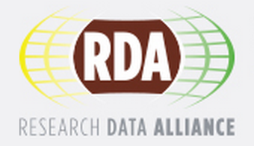
CIARD - global movement dedicated to open agricultural knowledge www.ciard.net
Global Open Data for Agriculture and Nutrition (GODAN) godan.info
Research Data Alliance (RDA) rd-alliance.org
  Agricultural Data Interoperability Interest Group
  Wheat Data Interoperability Working Group
e-Conference on Germplasm Data Interoperability

Slide 29
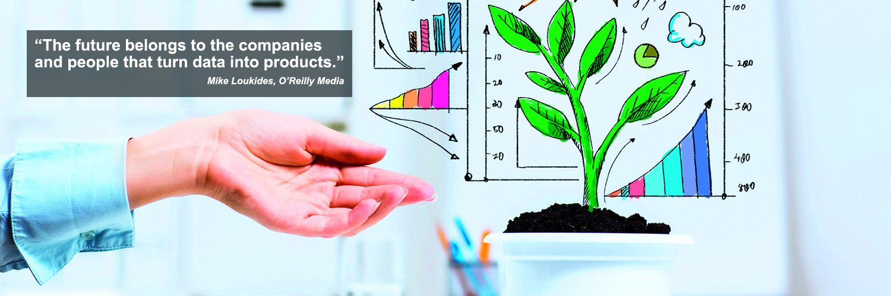
Thank you!
Contact: Andreas Drakos
drakos@agroknow.gr

